Slide 1
China in Decline (1800-1900)
East Asia: A Cultural, Social, and Political History
Chapter 18

Slide 2
Economic and Fiscal Problems
Population Growth and Land Pressure
By mid-19th century, population grows to over 400 million
Leads to land shortages
Surplus labor depressed wages
Female infanticide
Shortage of marriageable women
Traffic in women
Floating population
Notes:
Population Growth and Land Pressure
Population Boom: By the early 19th century, the Qing population had grown to over 400 million. This rapid increase strained the agrarian economy, leading to land shortages and over-farming.
Land Inequality: Wealthy landlords expanded their holdings, leaving many peasants landless or with insufficient plots to sustain themselves, increasing poverty and social unrest.
2. Stagnation of Agricultural Productivity
Despite population growth, agricultural innovation stagnated. Traditional farming methods could not keep up with the demand, leading to food shortages and periodic famines.
Soil Degradation: Over-cultivation further reduced productivity, exacerbating rural distress.

Slide 3
Economic and Fiscal Problems
Population Growth and Land Pressure
Stagnation of Agricultural Productivity
Traditional farming methods could not keep up with demand
Over-cultivation reduced productivity
Notes:
Population Growth and Land Pressure
Population Boom: By the early 19th century, the Qing population had grown to over 400 million. This rapid increase strained the agrarian economy, leading to land shortages and over-farming.
Land Inequality: Wealthy landlords expanded their holdings, leaving many peasants landless or with insufficient plots to sustain themselves, increasing poverty and social unrest.
2. Stagnation of Agricultural Productivity
Despite population growth, agricultural innovation stagnated. Traditional farming methods could not keep up with the demand, leading to food shortages and periodic famines.
Soil Degradation: Over-cultivation further reduced productivity, exacerbating rural distress.

Slide 4
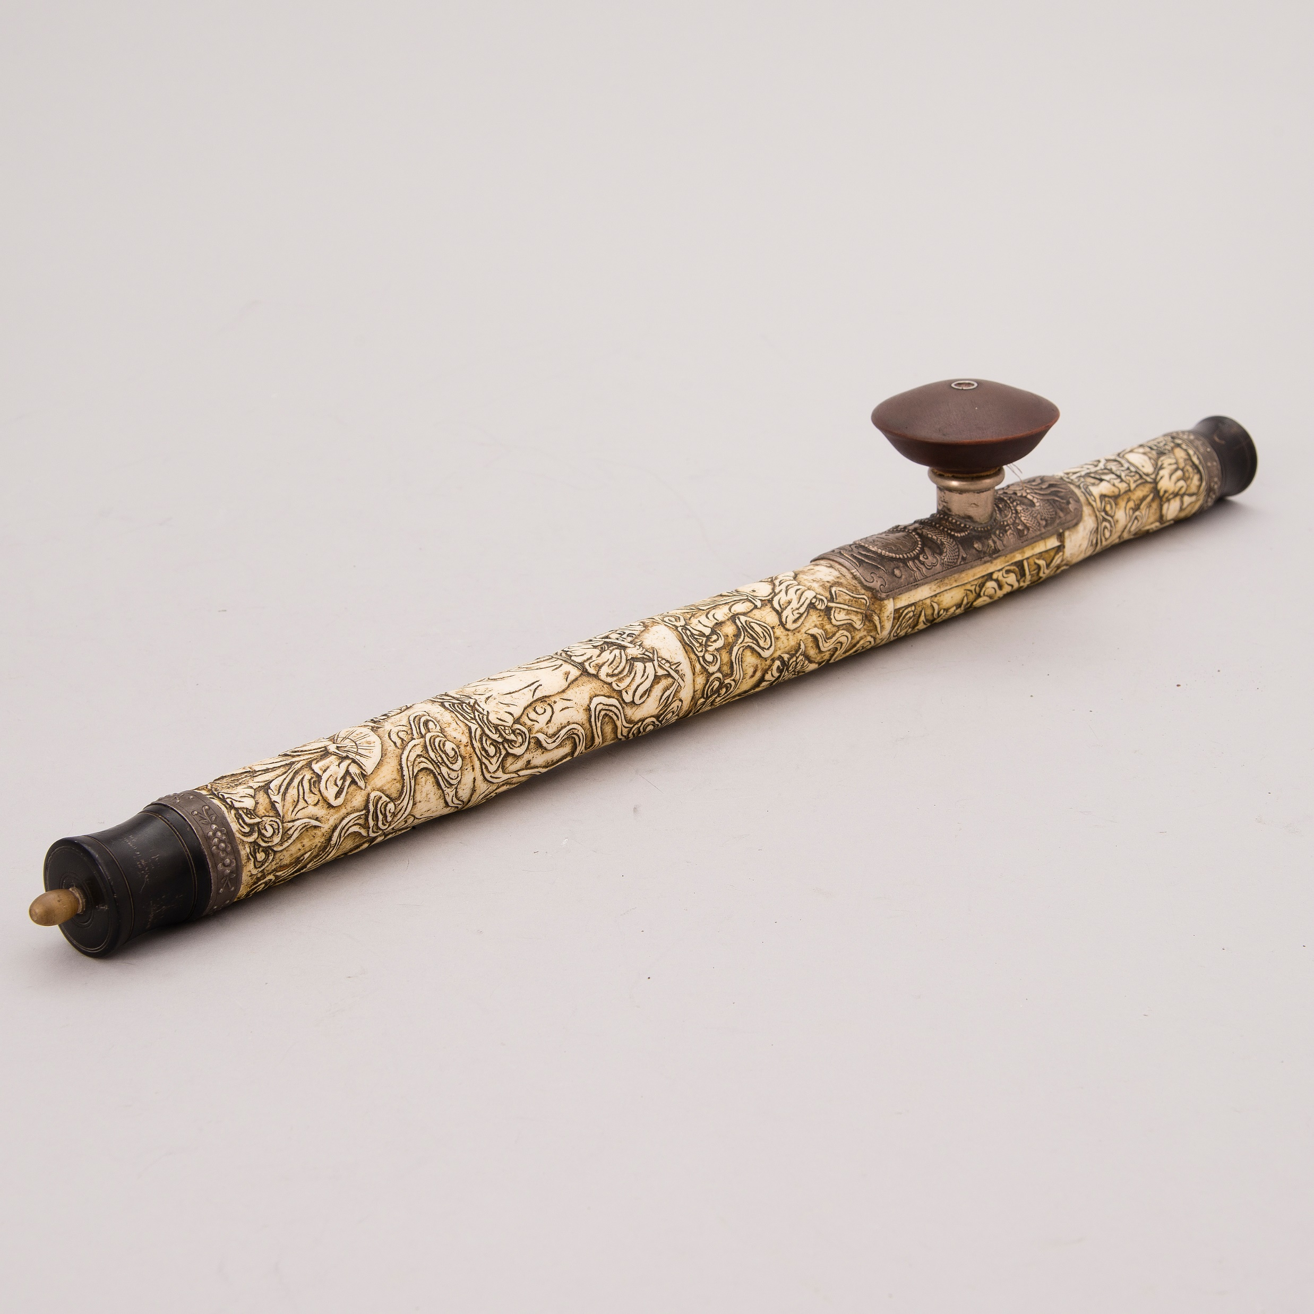
Economic and Fiscal Problems
Corruption and Inefficiency
Corruption was widespread
Central government struggled to collect taxes
Fiscal Strain
Influx of opium drained Silver
Created widespread addiction, futher weakened workforce and social fabric
Notes:
3. Corruption and Inefficiency
Local Governance Issues: Corruption was widespread among local officials, who often embezzled tax revenues and extorted peasants.
Failure of Tax Collection: The central government increasingly struggled to collect taxes efficiently, reducing its revenue base.
4. Fiscal Strain
Silver Drain: The Qing economy was heavily reliant on silver for currency. The early 19th century saw significant outflows of silver due to the growing imbalance in trade, especially as Britain began exporting opium to China.
Opium Trade Impact: The influx of opium not only drained silver but also created widespread addiction, which further weakened the workforce and social fabric.

Slide 5
Economic and Fiscal Problems
Military Expenditure
Recurrent uprising strained already depleted treasury
Reducing investment in infrastructure and disaster relief
Social Unrest
Fueled widespread discontent
19th century saw numerous uprisings and rebellions
Notes:
7. Military Expenditure
Recurrent uprisings, such as the White Lotus Rebellion (1796-1804) and smaller regional revolts, required heavy military spending, which strained the already depleted treasury.
By the 1840s, the government was diverting funds from development projects to maintain the military, reducing investment in infrastructure and disaster relief.
8. Social Unrest
The worsening economic conditions, compounded by the government’s inability to provide relief, fueled widespread discontent.
Uprisings: The early 19th century saw numerous uprisings, including the beginnings of the Taiping Rebellion (1850-1864), which was partly a reaction to the deteriorating economic situation.
Conclusion

Slide 6
Midcentury Crises

Slide 7
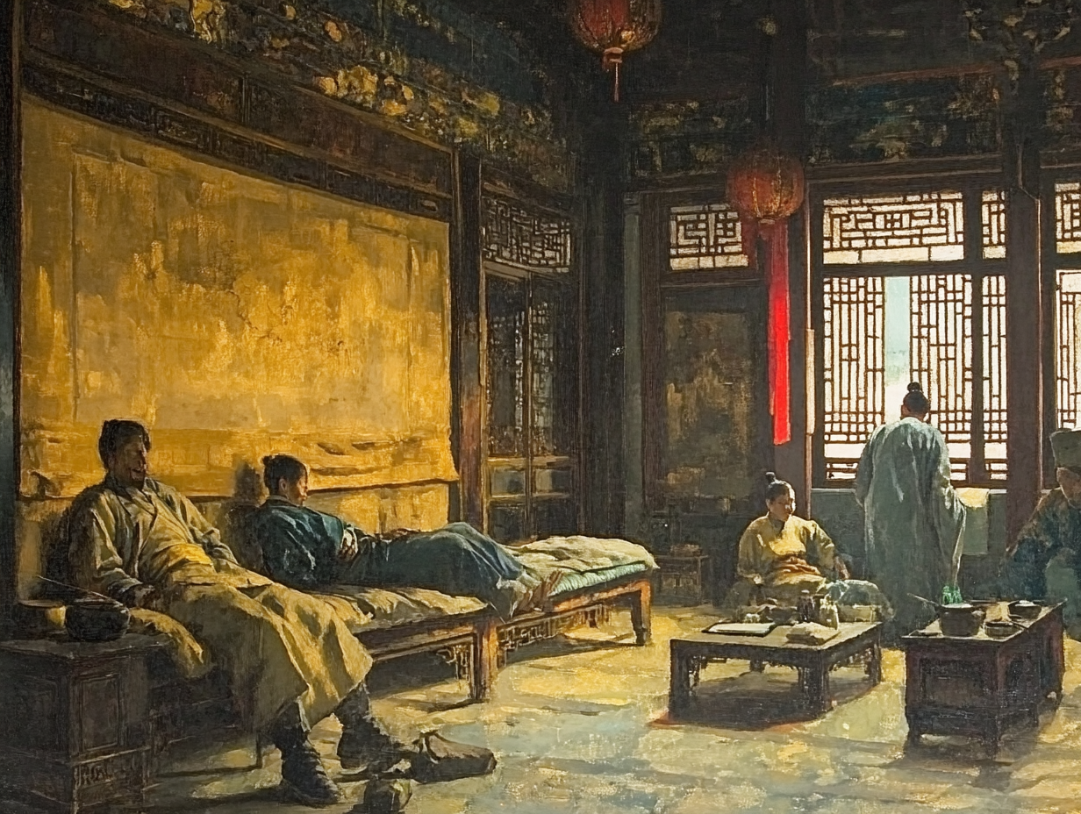
The Opium War (1839-1841)
British demand for Chinese goods (tea, silk, porcelain) created trade imbalance
Silver flows into China
Britain begins exporting opium
Widespread addiction creates health and social problems
Silver flows out of China, destabilizing Chinese economy

Slide 8

Notes:
https://www.youtube.com/watch?v=liXYDXM3tto

Slide 9
Opium War
1800 Qing bans the production and importation of opium; later bans smoking opium
1839, Lin Zexu appointed imperial commissioner to stamp out drug trade
Arrested 1,700 Chinese dealers; seized 70,000 opium pipes
Demanded foreigners surrender all opium and sign a pledge to refrain from selling opium
After six weeks, merchants turned over 2.6 million pounds of opium

Slide 10
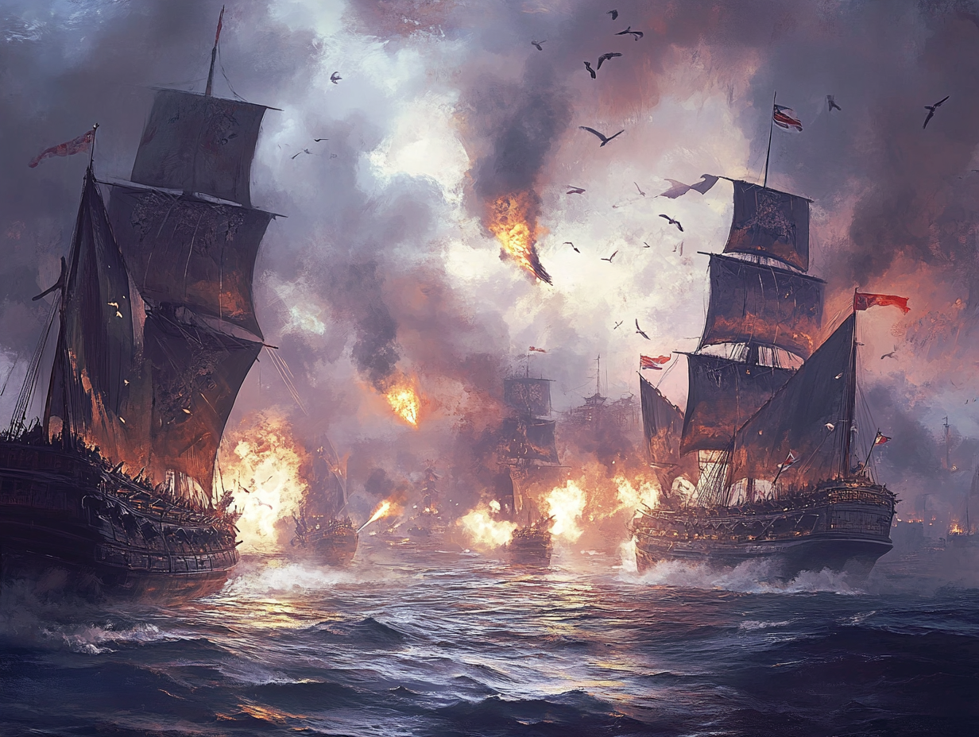
Opium War
British firms exerted pressure for a military response
British fire upon three Chinese war junk enforcing an embargo
1840 British expeditionary force arrives
shuts down major northern ports
British easily defeat Chinese navy
superiority in military technology
Qing had outdated weaponry and tactics

Slide 11
Treaty of Nanjing and the Treaty System
Unequal treaty
Canton System and Cohong monopoly abolished;
Ambassadorships in Beijing
five ports opened up to British trade; Hong Kong ceded to British
Established a Chinese tariff (ave. 5%)
Extraterritoriality
Most-favored-nation
Notes:
Significance of the Treaty of Nanjing – ended the Canton system; exposed to China and the West the “fact that Qing military technology was hopelessly obsolete.”

Slide 12
Significance of the Opium War
Ended the Canton System, opening China to Western trade.
Exposed military weaknesses of the Qing Dynasty.
Set pattern for unequal treaties.
Forced China to trade on Western terms.
Marked a victory for Western imperialism.
Opened the floodgates for other Western powers to demand concessions.

Slide 13
The Taiping Rebellion (1850-1864)
A Turning Point in Qing Dynasty History

Slide 14
Hong Xiuquan: Leader of the Taiping Rebellion
Born in 1814, failed multiple civil service exams.
Experienced visions during illness, believed himself to be the younger brother of Jesus.
Founded the 'Association of God Worshippers' and declared the 'Heavenly Kingdom of Great Peace' (Taiping Tianguo).
Combined Christian elements with anti-Manchu rhetoric.

Slide 15
Growth of Movement
Initially focused on spiritual revival and anti-Manchu rhetoric.
Rapidly gained followers, particularly among disaffected peasants and marginalized groups.
Evolved into a militarized movement as tensions with Qing authorities escalated.
Organized and disciplined troops, leveraging religious zeal to strengthen morale and unity.
Early victories against Qing forces boosted their confidence and territorial control.

Slide 16
Key Events of the Taiping Rebellion
Rapid military advances, capturing Nanjing in 1853.
Established Nanjing as the capital of the Taiping Heavenly Kingdom.
Momentum stalled due to internal divisions and lack of external alliances.
Western powers and regional Qing forces counterattacked.

Slide 17
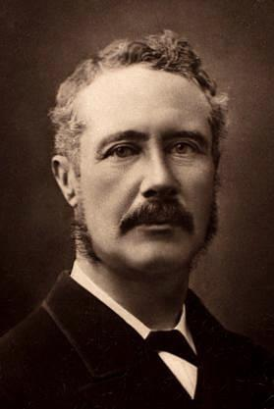
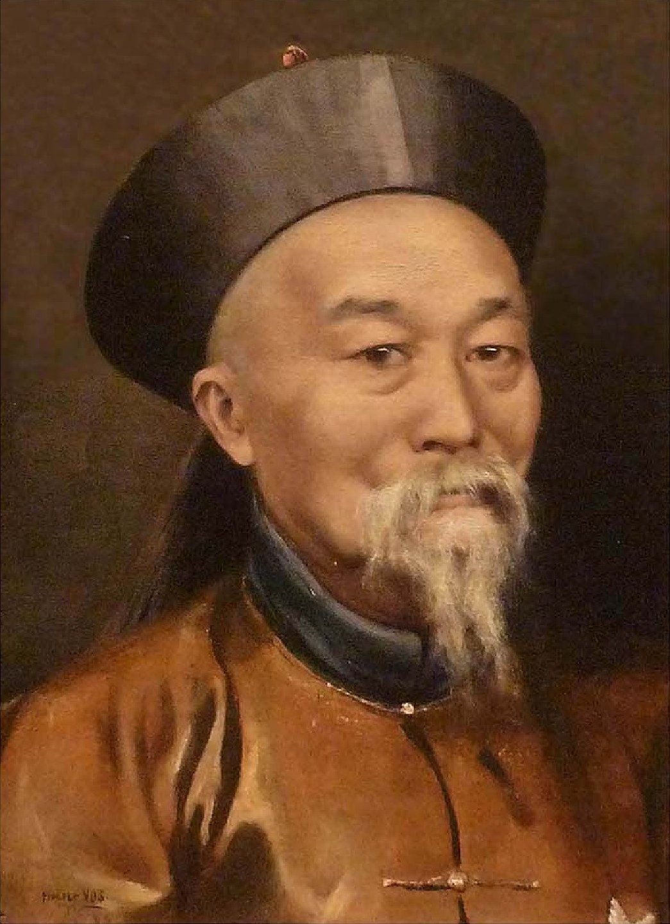
Regional and Western Forces
Hunan and Anhui Armies: Regional militias led by Qing loyalists.
Ever Victorious Army: Western-trained force, instrumental in defeating the Taiping.
Qing reliance on regional forces weakened central authority.

Slide 18
Challenges Faced by the Taiping
Religious fanaticism limited alliances with secret societies and other rebellions.
Anti-Confucian rhetoric alienated potential scholarly supporters.
Leadership struggles and internal corruption weakened the movement.
Strategic errors, including the halt at Nanjing.

Slide 19
Significance of the Taiping Rebellion
One of the largest conflicts of the 19th century, with 20-30 million casualties.
Shifted power from Qing central authority to regional warlords.
Highlighted the Qing's vulnerability and set the stage for further uprisings.
Marked a turning point in the decline of the Qing Dynasty.

Slide 20
Self-Strengthening
II. 1870-1894

Slide 21
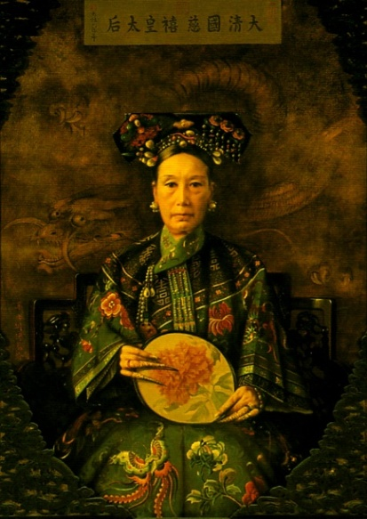
The Empress Dowager Cixi
Delivered the Xianfeng emperor’s only son
Became co-regent with Prince Gong when her son ascended the throne as the Tongzhi Emperor
Maintained control by placing minors on the throne

Slide 22
Tongzhi Restoration
Feng Guifen (1809-1874) proposes wide-ranging reforms
Learn from “barbarians” to set up shipyards and arsenals
Translate western books on mathematics and science
High officials elected by lower officials
Prince Gong sides with modernizers
“For the time being, we have to make use of foreigners to train our soldiers, as a scheme for self-strengthening.”

Slide 23
Self-Strengthening – The First Phase
Fortify the Qing through selective borrowing from the West
Arsenals and dockyards established
Schools opened to teach European languages and international law
Foreign office (Zongli Yamen) opened to manage diplomatic affairs

Slide 24
Self-Strengthening – The First Phase
Fortify the Qing through selective borrowing from the West
Failed to take off due to conservative opposition
Apprehensive that changes would undermine traditional values and existing power structure
Opposed to cooperating with arrogant foreigners
Limited to periphery

Slide 25
Sino-Japanese War
Insurrection breaks out in Korea; Both China and Japan sends troops
Japan attacks and sinks a Chinese ship; both sides declare war
Japan had modernized quickly and well; China proved no match for Japan’s now modern military
Japan defeats China very quickly
Treaty of Shimonoseki
China ceded Taiwan and Liaodong peninsula
Allows Japan to open factories in China
China forced to pay indemnity (200 million oz silver)
Begins debt to western nations
Triple Intervention

Slide 26
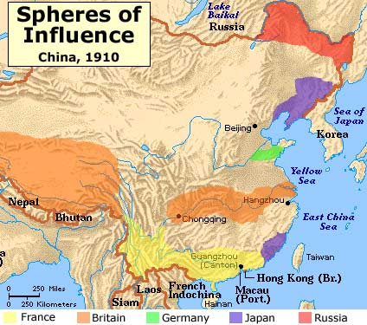
Scramble for Concessions
Western imperialism at its height
Spheres of Influence
Special rights and privileges to Western powers and Japan
Notes:
Interactive Imperialism Map available on MyHistoryLab
Map of spheres of influence - print
China’s display of weakness in the war against Japan set in motion a scramble for special rights and privileges in which Russia, France, Britain, Germany, and Japan pursued their national interest and jockeyed for position in case China collapsed.
Special Rights included:
Loans were forced on the Qing, secured by Tax revenues, such as maritime customs
Long term leases of Chinese territory
Development of economic resources such as mines and railroads
Rights to police areas
Nonalienation pact – China agrees not cede a territory to any power other than the signatory

Slide 27
Origins of Radical Reform
Missionaries and Merchants turn to home governments for aid and defense: Gunboat diplomacy
Brought secular knowledge, established schools, hospitals, orphanages
Humiliation at defeat in Sino-Japanese War (1895)
Give rise to nationalists willing to advocate more radical changes

Slide 28
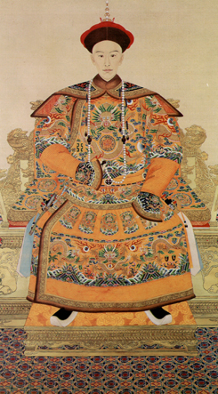
Hundred Days’ Reform
Reaction to defeat and Western imperialism
Emperor issues more than 40 edicts; addressed every aspect of Chinese society
Exam system abolished
New schools established
Administration revamped
Military revamped
Corruption attacked
Notes:
Hundred Days of Reform
(1898), in Chinese history, imperial attempt at renovating the Chinese state and social system. It occurred after the Chinese defeat in the Sino-Japanese War (1894–95) and the ensuing rush for concessions in China on the part of Western imperialist powers.
Following the Sino-Japanese War, a series of clubs sprang up across China urging reform on the Western model. One of these was founded by a civil service examination candidate, K'ang Yu-wei, who led a group of other candidates in the writing of a “Ten Thousand Word Memorial,” which advocated the rejection of the peace treaty and the institution of a whole series of reforms. This petition was ignored by the imperial government. Meanwhile, within established official circles, a group of conservative reformers—led by Chang Chih-tung, whose famous work Ch'üan-hsüeh p'ien (“Exhortation to Learning”) was distributed in 1898—called for the development of Western-style industrialization without the abandonment of China's cultural heritage.
Spurred by this group and alarmed by the slow dismemberment of China by Western powers in the wake of the Sino-Japanese War, the government began to seriously consider the idea of reform. As a result K'ang finally came to the attention of the Kuang-hsü emperor, and in January 1898 he met with a group of high government officials. On June 11, 1898, the emperor acceded to one of K'ang's requests and issued his first reform decree, urging his subjects to learn useful foreign information. This was the start of what was to be known as the Hundred Days of Reform. On June 16, 1898, K'ang was given his first interview with the emperor. Thereafter the government officials who had been advocating moderate reforms were pushed to the background, and K'ang, his famous disciple Liang Ch'i-ch'ao, and other followers became trusted imperial advisers.
In all, the emperor issued more than 40 edicts, which if enacted would have transformed every conceivable aspect of Chinese society. The old civil service examination system based on the Chinese Classics was ordered abolished, and a new system of national schools and colleges was established. Western industry, medicine, science, commerce, and patent systems were promoted and adopted. Government administration was revamped, the law code was changed, the military was reformed, and corruption was attacked.
The attack on corruption, the army, and the traditional educational system threatened the privileged classes of traditional Chinese society. Conservative forces rallied behind the empress dowager; with the army on her side, she carried out a coup d'état and imprisoned the emperor in his palace. K'ang and Liang managed to escape to Japan, but six other young reformers were executed. Although some moderate reform measures, such as the establishment of modern schools, were retained, the examination system was reestablished and most of the reform edicts, which had never been enacted anyway, were repealed. In the early 1900s, officials like Chang Chih-tung were allowed to carry out a full-scale reform effort, but it was a piecemeal, belated effort. The failure of the Hundred Days marked the last attempt at a radical revolution by the imperial regime in China.
" Hundred Days of Reform ." Encyclopædia Britannica. 2006. Encyclopædia Britannica Premium Service. 3 Apr. 2006 <http://www.britannica.com/eb/article-9041530>.

Slide 29
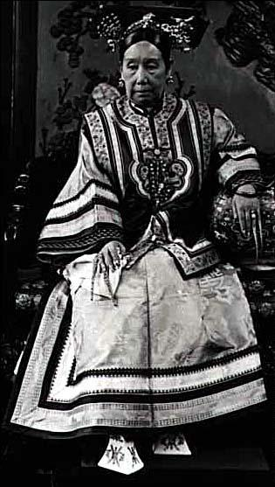
Hundred Days’ Reform
Reaction to defeat and Western imperialism
Emperor issues more than 40 edicts; addressed every aspect of Chinese society
Conservative Reaction
Notes:
Conservative Reaction
Edicts threatened privileged status of elite
Rally around Empress Dowager
Placed emperor under house arrest; declared he was deathly ill
Edicts annulled; Reformers executed or forced into exile
Kang Youwei flees to Japan; travels extensively in West where he mobilizes overseas Chinese

Slide 30
The Boxer Rebellion
Video: China’s Boxer Rebellion

