Slide 1
The Creation of the Manchu Empire
Chapter 16
Notes:
For good maps of dynasties use http://www.mnsu.edu/emuseum/prehistory/china/index.html

Slide 2
The Manchus

Slide 3
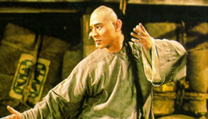
The Manchus
Jurchen stock
Descendants of Jin dynasty
Maintained distinct hairstyle
Homeland Manchuria
Tribal Social Structure
Hunting, fishing, farming
Strongly hierarchical
Lamaist Buddhism coexisted with Shamanism
Traded with Mongols, Chinese, and Korean at border markets
Notes:
Manchurians brought horses, fur, honey, and ginseng, in exchange for Chinese tea, cotton, silk, rice, salt, and tools.

Slide 4
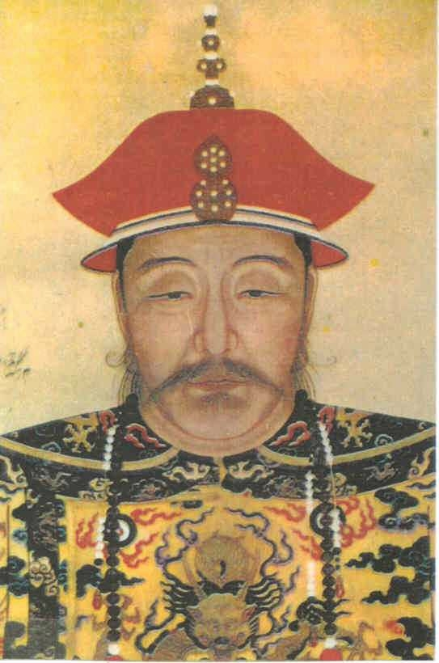
Nurhachi (1559-1626)
At age 24, becomes leader of one tribe
United Manchus through fighting, negotiating, and marriage politics
Banner system
multi-ethnic social-political-military organization
24 Banners (Manchu, Mongol, and Chinese)
1616 declared himself khan of the later Jin, overran Liaodong

Slide 5
Nurhachi (1559-1626)
At age 24, becomes leader of one tribe
United Manchus through fighting, negotiating, and marriage politics
Banner system
1616 declared himself khan of the later Jin, declared war on Ming
overran Liaodong
1626 Died

Slide 6
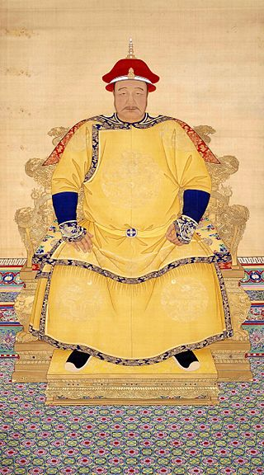
Hong Taiji
Makes use of Chinese bureaucrats, but intent of replacing with multi-ethnic elite
1636 Hong renames state Qing (“pure”)
1643 Hong Taiji dies
His brother (Dorgon) made regent for five year old Shunzhi Emperor
Notes:
Death – possibly at hands of one of his officials.

Slide 7
Overthrow of the Ming
Ming collapses due to domestic problems and rebellion
Ming General Wu Sangui
Stationed at Shanhaiguan (eastern terminus of Great Wall)
Allowed Manchus to pass
1644 Qing proclaim they had come to punish rebels; claims to be legitimate successor
Buries deceased Ming emperor with full honors
Reestablishes Exam System
Reestablishes Traditional Chinese Government

Slide 8
Overthrow of the Ming
Forty years of bloody warfare to pacify rest China
Wu Sangui and other Chinese generals join forces with Manchus

Slide 9
Qing Legitimacy
Manchu’s comprised no more than 2% of population
Mandate does not require ethnic Chinese
How to maintain ethnic identity
Forbidden to intermarry
Maintained dress, family rituals, diet, & lifestyle
Manchu women forbidden from binding feet

Slide 10
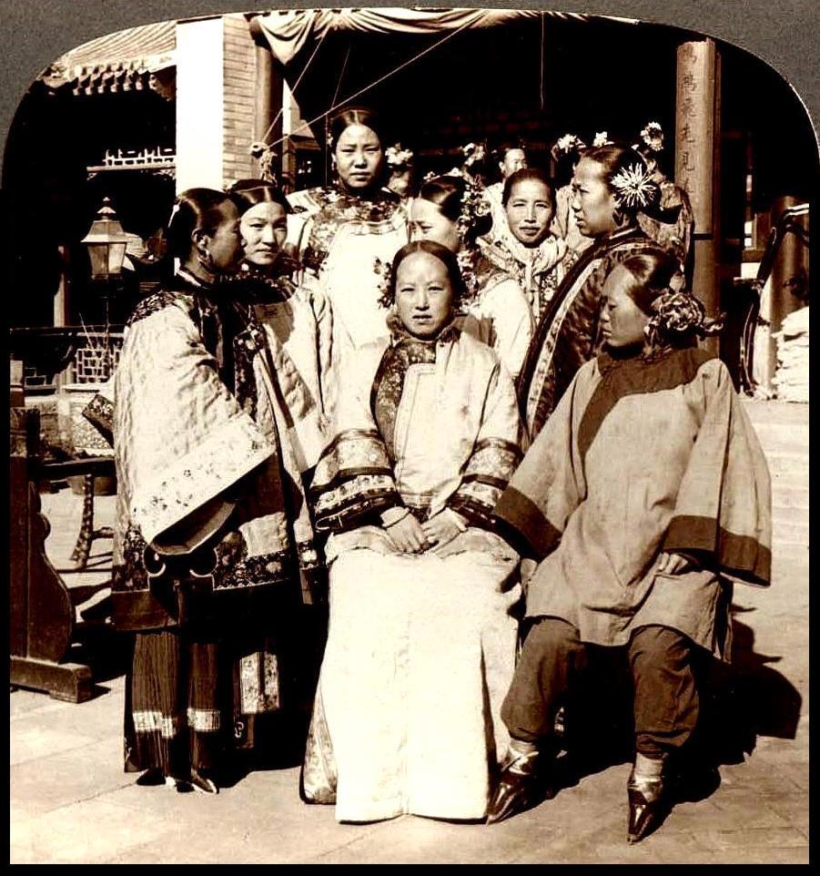
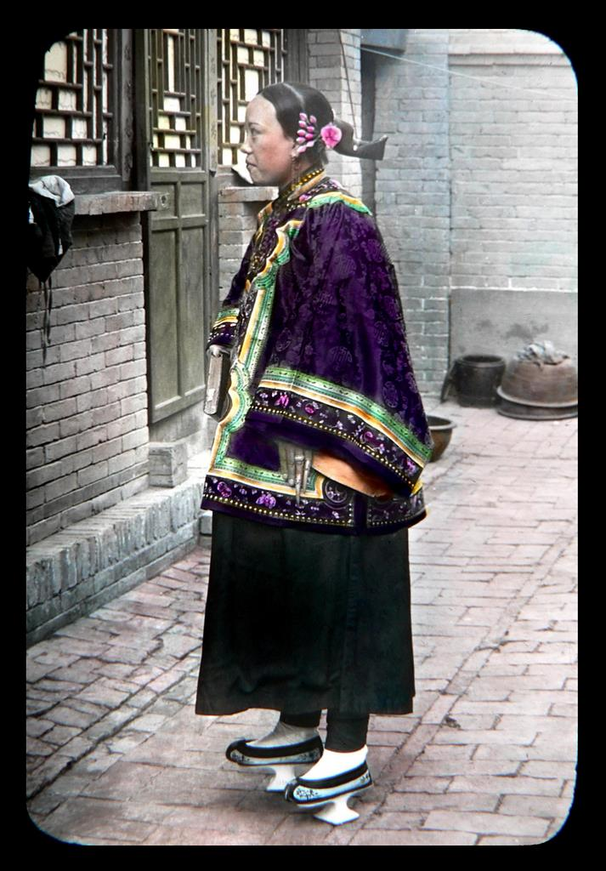
Manchu Women

Slide 11
The Qing Emperors’ Nianhao
Era Name | Temple | Personal | Dates
Shunzhi | Shizu | Fulin | 1644-1661
Kangxi | Shengzu | Xuanye | 1662-1722
Yongzheng | Shizong | Yinzhen | 1723-1735
Qianlong | Gaozong | Hongli | 1736-1795
Jiaqing | Renzong | Yongyan | 1796-1820
Daoguang | Xuanzong | Minning | 1821-1850
Xianfeng | Wenzong | YiZhu | 1851-1861
Tongzhi | Muzong | Zaichun | 1862-1874
Guangxu | Dezong | Zaitian | 1875-1908
Xuangzong | None | Puyi (Henry) | 1909-1911
Notes:
http://en.wikipedia.org/wiki/Nian_Hao

Slide 12
Ming Loyalism

Slide 13
Ming loyalism
Ming officials move the court to Nanjing; place a Ming prince on the throne
Offer to buy off Manchus refused
Manchus destroy rebel forces destroyed by 1647
Manchus then attack Ming forces
Many Ming officials join the Ming cause
However, many others defect to Manchu side
Ming cities open gates to Manchus; those who refused were slaughtered
As cities fell, many committed suicide

Slide 14
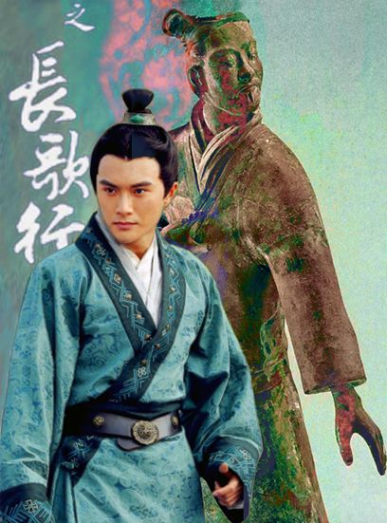
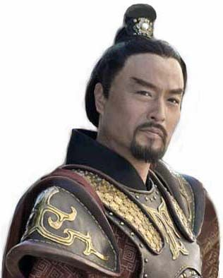
Politics of Hairstyles
Chinese Top Knot
Notes:
Traditional hairstyle, dates back to Antiquity. Linked to Confucian filial piety. Deeply associated with Chinese-ness, to shave the head indicated anti-social behavior, uncivilized, barbarian.

Slide 15
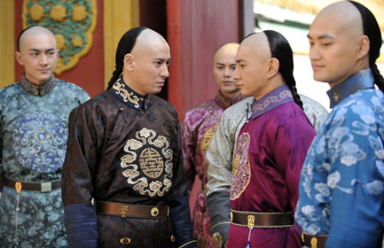
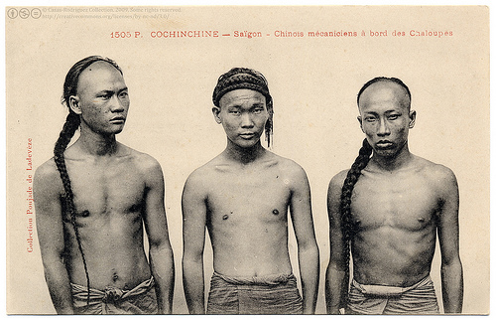
Politics of Hairstyles
Manchurian Queue

Slide 16
Politics of Hairstyles
1645 Imposed on Chinese serving in Banners
Soon extended to all Chinese males
Discuss
Notes:
Easier to distinguish loyal Chinese from rebels/Ming loyalist
Symbolic of Chinese submission to Ming authority

Slide 17
Ming Scholars
Many scholars refused to serve the Qing
Some actively participated in resistance
Qing overthrow caused scholars to rethink traditional worldview
How and why did the Ming collapse

Slide 18
The Qing at its Height

Slide 19
The Qing at its Height
Effective Monarchs
Population growth (Doubled during 18th Century)
Global warming extended growing season
Slowing of new diseases
Famine relief
Introduction of New World Crops to China
Solves famines, increases population – however,
Leads to deforestation, flooding, and rebellion
Destabilizes dynasty, making it vulnerable to European encroachment

Slide 20
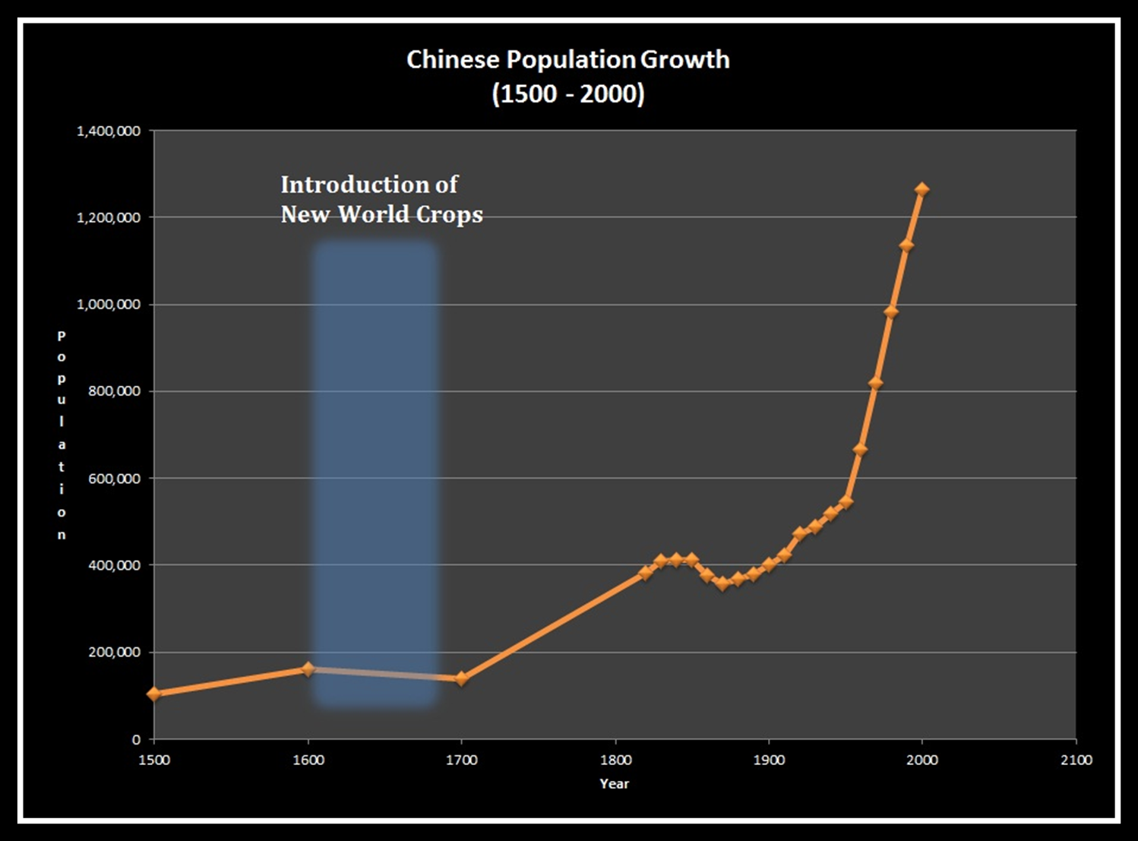

Slide 21
The Qing at its Height
Effective Monarchs
Population growth (Doubled during 18th Century)
Standard of living compares favorably to Europe

Slide 22
Jian Chun, Salt Merchant
Biography

Slide 23
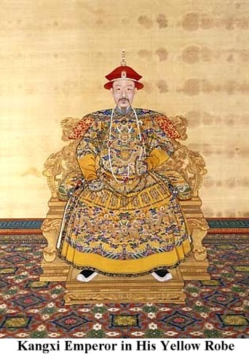
Reign of Kangxi
Completed Manchu conquest of China
Primarily with Chinese troops
Destroyed Russian Cossack base; signed Treaty of Nerchinsk in 1689
1696 Defeated Mongols
Expelled Mongols from Tibet; installed pro-Chinese Dalai Lama
Defeat of Wu Sangui
Notes:
Kangxi was one of the most successful emperors of all Chinese history
Zest for hunts; closed Manchuria to Chinese immigration.
Maintained strict balance between Manchu and Chinese officials.

Slide 24
Reign of Kangxi
Very much Manchu; but not anti-Chinese
Closed Manchuria to Chinese immigration
Maintained balance between Manchu and Chinese
Worked to attract Ming loyalists

Slide 25
Reign of Kangxi
Vigorous Man and Effective ruler
Rose before dawn each day
Wide intellectual interests
Patronized arts and sponsors intellectual projects
Special support to philosophy of Zhu Xi

Slide 26
Qianlong
Achieved greatest prosperity and expansion
Qing Expansion
Divide and rule policies
Ability to work with Inner Asian leaders and symbols of authority
Declining strength of Inner Asian peoples
Notes:
Dynasty’s most splendid reign.

Slide 27
Qing Expansion
Incorporated Chinese Turkestan (Xinjiang)
Conquered Ili in the West
Dominated Outer Mongolia & Tibet
Fought two bloody wars against Tibetan minority
Involved millions of square miles and as far away as Burma, Vietnam, and Nepal creating a multi-ethnic empire
Notes:
Dynasty’s most splendid reign.
Map on p. 264

Slide 28
Qing Expansion
To foster loyalty among Mongols and Tibetans drew on Buddhist tradition
Six Tangkas portray him as Manjusri

Slide 29
The Emperor’s Paradise
Unprecedented prosperity; Qianlong riches man in world
Patronage of scholarship but suspicious of anti-Manchu writings
Complete Library of Four Treasuries
3462 complete works in 36,000 volumes
Suppressed anti-Manchu writings
80% officials were Chinese; but required Manchus to retain ethnic identity
Notes:
Compilation of Manchu history and genealogies; study and use of Manchu language; all customs that set Manchu apart from Chinese such as dress, ear-rings, etc. Manchu women forbidden to bind feet.

Slide 30
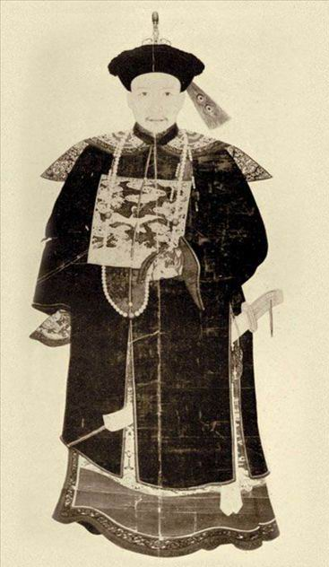
Corruption
Heshen (1750-1799) gained favor of Qianlong emperor
Received highest ministerial positions in empire
Systematic embezzelment
Lined his own pockets with money allocated to suppress rebellion
Removed only after the death of the Qianlong emperor, having amassed a vast fortune

Slide 31
Fang Bao’s “Random Notes from Prison”
Documents

Slide 32
Banner System
Military organization used to conquer and control China
Organized warriors into companies distinguished by banners of different colors
All followers of Nurhaci organized into banners
Served military and administrative functions
Banners included families and slaves
Reduces importance of tribal affiliation
Notes:
the military organization used by the Manchu tribes of Manchuria (now Northeast China) to conquer and control China in the 17th century. The Banner system was developed by the Manchu leader Nurhachi (1559–1626), who in 1601 organized his warriors into four companies of 300 men each. The companies were distinguished by banners of different colours—yellow, red, white, and blue. In 1615 four more banners were added, using the same colours bordered in red, the red banner being bordered in white. As the Manchu increased their conquests, the size of the companies grew until each came to number 7,500 men divided into five regiments, divided, in turn, into five companies.
All of Nurhachi’s followers, with the exception of a few imperial princes, were organized into this Banner system, which also served an administrative function. Taxation, conscription, and registration of the population were carried out through the banner organization. The bannermen lived, farmed, and worked with their families during times of peace, and in times of war each banner contributed a certain number of fighting men.
As the Manchu began to conquer their Chinese and Mongol neighbours, they organized their captives into companies modeled after the banners. In 1635 eight Mongol banners were added to the Manchu system, and in 1642 eight Chinese banners were added. The new banners, which fought alongside the old, brought to 24 the total number of banner units. With these troops, the Manchu were able to conquer China and establish the Qing dynasty (1644–1911/12).
After the establishment of the dynasty, a constabulary Army of the Green Standard was garrisoned throughout the country to quell minor disturbances; this army consisted mainly of former Ming remnants and local forces. The main Manchu force continued to be the 24 banners, which were garrisoned at the capital in Beijing and in several selected strategic spots throughout the country, where they could be called quickly in the event of an emergency.
In the early Qing period the emperor controlled only three of the eight Manchu banners, the others being under the rule of various imperial princes. But when the emperor Yongzheng ascended the throne in 1722, he took control of all eight banners to prevent his brothers from attempting to usurp the throne. Thereafter, the banners were the sole possession of the Qing emperors and their greatest source of power.
The bannermen were considered a form of nobility and were given preferential treatment in terms of annual pensions, land, and allotments of rice and cloth. Manchu bannermen were on the whole treated better than their Mongol and Chinese counterparts, but all were prohibited from participating in trade and manual labour unless they petitioned to be removed from banner status. Moreover, those who broke the law were not tried before an ordinary civil magistrate but by a special Manchu general.
During the century and a half of peace following the establishment of the Qing, the fighting qualities of the banner forces deteriorated, and their training was neglected. During the White Lotus Rebellion (1796–1804) and then again during the Taiping Rebellion (1850–64), the banners were unable to protect the dynasty, and the government eventually had to organize other forces. By the end of the 19th century the Banner system, with the exception of a few thousand bannermen trained in modern methods and weapons, had become totally ineffective.

Slide 33
Banner System
As Manchus conquered Mongols and Chinese, captives organized into companies modeled after banners
Organized by ethnicity
Chinese, Mongol, Manchu
Each banner with separate color
Membership in banner was hereditary
By 1644 – 24 Banners, stationed throughout dynasty, lived apart from population
Use of Chinese artillery experts & bureaucrats
With these troops, the Manchu were able to conquer China and establish Qing dynasty

Slide 34
Banner System
Bannermen considered a form of nobility
Constabulary Army of the Green Standard
Consisted mostly of Ming remnants and local forces
Garrisoned throughout country to quell minor disturbances
Fighting quality deteriorated and training neglected

Slide 35
Contacts with Europe

Slide 36
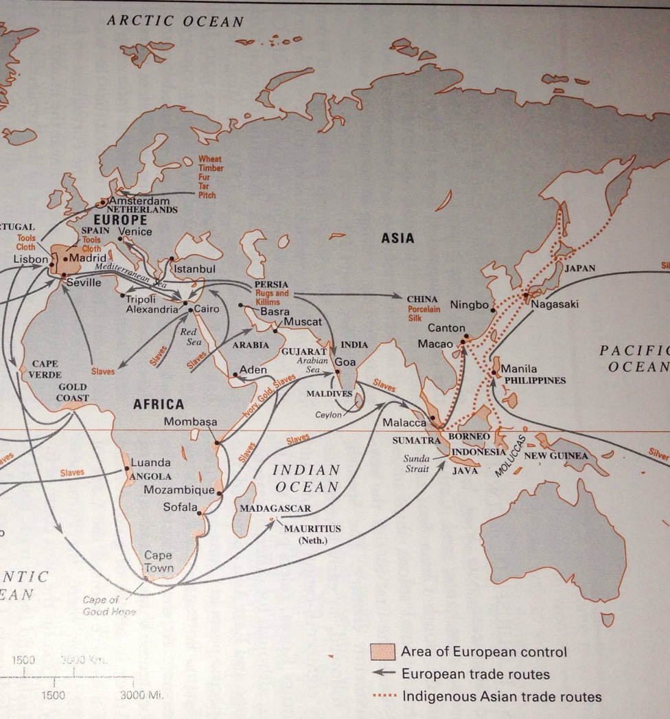
The Portuguese in East Asia
Establish Asian headquarters at Goa in 1510; captured Malacca in 1511
Desire to break the Arab spice monopoly
No European commodities of equal value (later new world silver come from Spanish) – Portuguese become shippers
“ocean devils” – new barbarian that eats children
1557 Portuguese allowed to establish on Maco; 1887 Macao officially ceded to Portugal

Slide 37
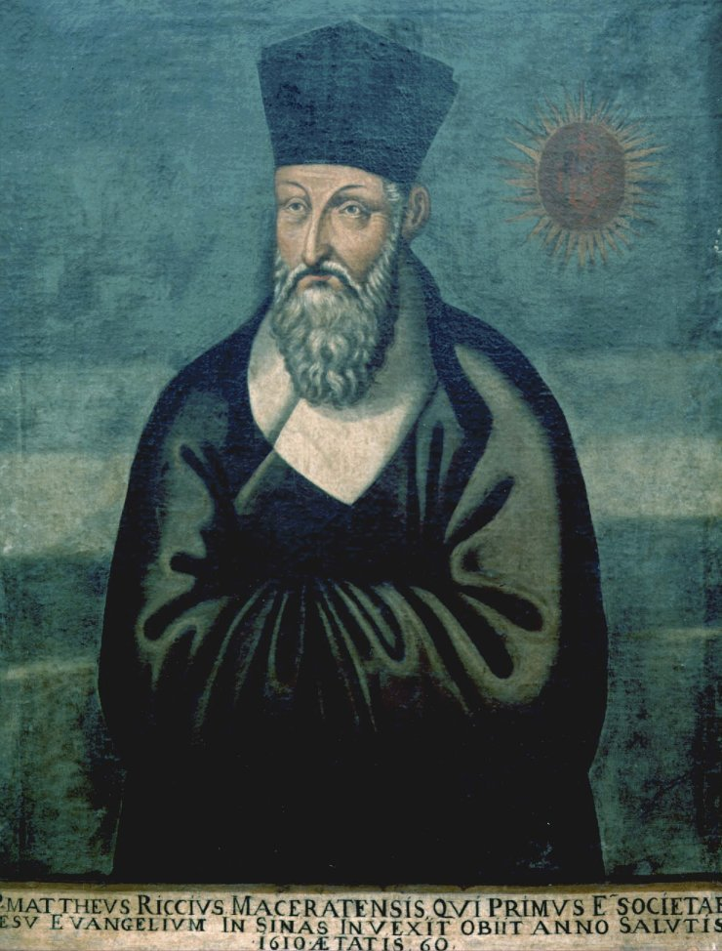
Jesuits in China
Matteo Ricci resides in Beijing in 1601
Polymath; Chinese impressed with knowledge
Adopted Confucian garb
Adam Schall von Bell
Trained astronomer served as chief government astronomer
Jesuits served at Court as astronomers and cartographers

Slide 38
Rights Controversy
Are ancestor rites secular or religious?
Dominicans and Franciscan argue with Jesuits over Ancestral Altars
Jesuits argue that ancestor rites are secular and not incompatible with Christianity
Pope issues edict forbidding ancestor worship by Chinese Christians
Kangxi Emperor Outlawed Christianity and expelled missionaries

Slide 39
Canton System
Foreign merchants restricted to Canton
Warehouse (factories) set aside for foreign use
Families not permitted
Limited to Cohong (association of firms)
No access to Chinese government or direct government to government relations
British East India Company
Monopoly of trade between England and China
Agent of British imperialism

Slide 40
Macartney Mission
Imbalance of trade; merchants dissatisfied with restrictions
King George sends Lord George Macartney to negotiate with the Qing Emperor
Secure place for British near tea producing areas
Negotiate a commercial treaty
Create a desire for British goods
Arrange for diplomatic representation in Beijing

Slide 41
Macartney Mission
Imbalance of trade; merchants dissatisfied with restrictions
King George sends Lord George Macartney to negotiate with the Qing Emperor
Macartney refuses to Kaotao; allowed informal meeting with the Qianlong emperor
No formal negotiations followed; China had no desire to alter terms of trade
Members of embassy return and write about China

Slide 42
18th Century Government, Society, and Economy
Notes:
Assign Video Lecture: http://www.youtube.com/watch?v=_qdxBt9uE58

Slide 43
Granaries
Granaries existed in almost every county
Corporate lineages constructed and maintained
“Ever-Normal Granaries”
Corporate Lineages are kinship groups whose members often live, work, play, and pray together. Property is controlled by the group, people derive their primary identity from the group, and even religion (in the form of ancestor worship) is a lineage matter. Acting like a small corporation, the lineage has a powerful impact on the everyday lives of its members.

Slide 44
Education
Village Lectures
Sacred Edict
Esteem most highly filial piety and brotherly submission, in order to give due importance to human moral relations.
Behave with generosity toward your kindred, in order to illustrate harmony and benignity.
Cultivate peace and concord in your neighborhoods, in order to prevent quarrels and litigations.
Village schools

Slide 45
A Buoyant Economy

Slide 46
Population Growth
By the end of the 18th century, population reached 300 million
Increase in life expectancy and living standards compared favorably to Europe at time

Slide 47
A Buoyant Economy
Population Growth
Increase in Agricultural Yield
Specialized strains of rice
Irrigation; terracing; storage
Better fertilizers
Land Reclamation
Extended growing season

Slide 48
A Buoyant Economy
Factors contributing to Population Growth
Increase in Agricultural Yield
Introduction of New World Crops, e.g. sweet potato, peanuts, corn
Slowing of Disease
Efficiency of government relief

Slide 49
Commercial Crops
Increase in yield followed by commercialization
Sell grain on open markets
Use land to grow cash crops, such as
Tea
Sugar
Cotton
Hemp
Tobacco
Mulberry trees

Slide 50
Manufacturing
Ceramics, brewing, paper, mining, metal, silk, and cotton textile
Chinese Shipping predominated
Balance of Trade in China’s Favor
New World silver flows into China to pay for highly desired Chinese goods
Growth of Market Towns and sophisticated banking system and water-transport system

Slide 51
Social and Cultural Crosscurrents

Slide 52
Conservative Turn
Wang Yangming undermined commitment to duty and respect for authority
Call for return to Zhu Xi’s teachings
Prostitution, homosexuality, and the theatre proscribed
Cult of Widow Chastity
“It would be better for a widow to starve to death rather than to remarry”
Cheng Yi

Slide 53
Eight Eccentrics of Yangzhou
Group of 8 painters who rejected convention, personally and artistically
Ink painting for self-expression; individual style
Often sold art for money

Slide 54
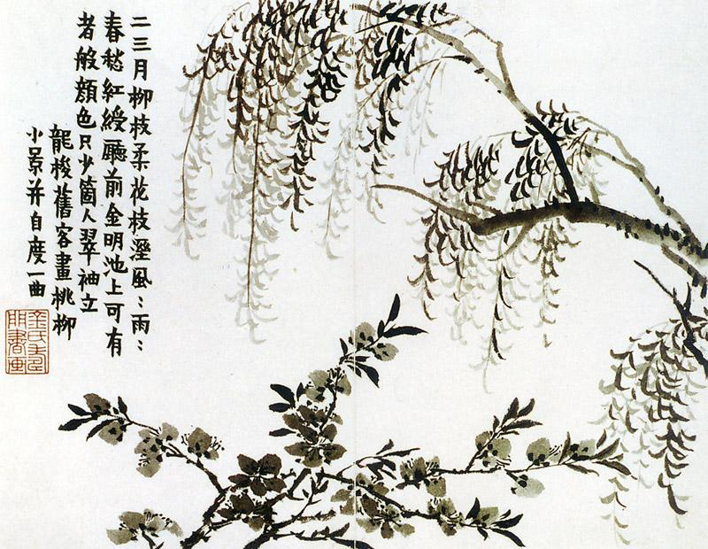
Jin Nong
Unique Calligraphy
Mei Blossoms
Self-Portraits
Sold paintings in open market

Slide 55
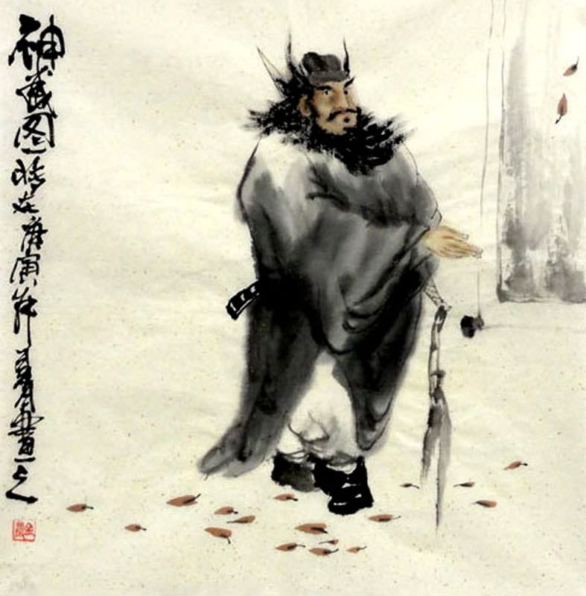
Jin Nong
Unique Calligraphy
Mei Blossoms
Self-Portraits
Genre Paintings
Sold paintings in open market

Slide 56
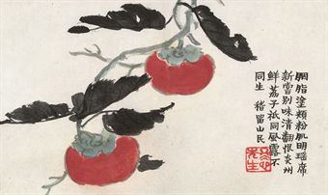
Jin Nong
Unique Calligraphy
Mei Blossoms
Self-Portraits
Genre Paintings
Sold paintings in open market

Slide 57
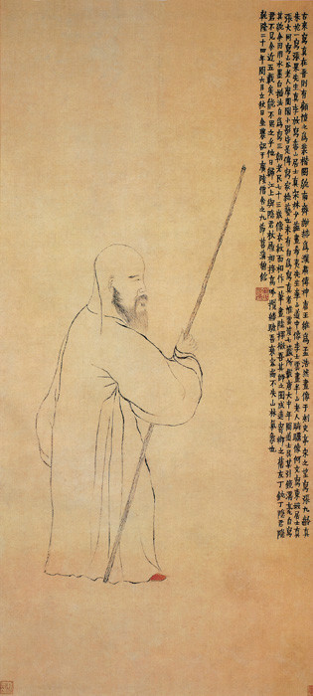
Jin Nong
Unique Calligraphy
Mei Blossoms
Self-Portraits
Genre Paintings
Sold paintings in open market

Slide 58
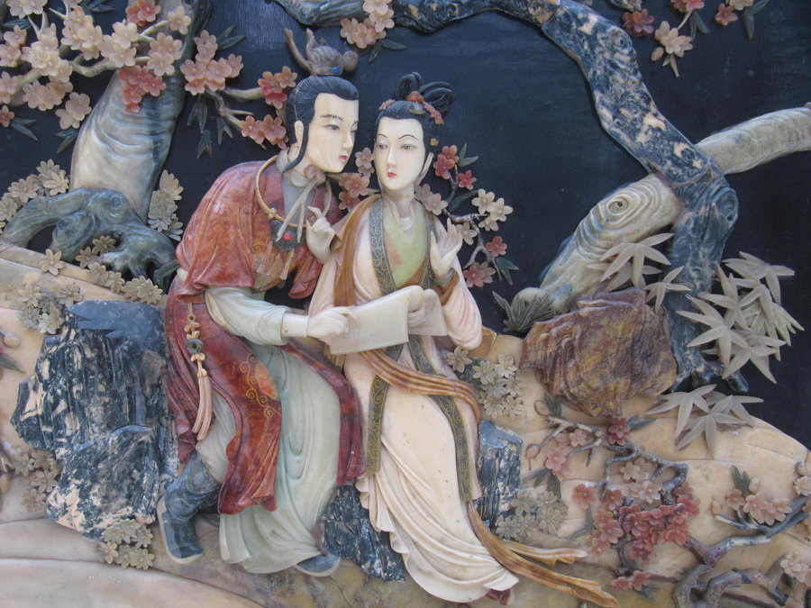

The Dream of the Red Mansions
Notes:
http://www.npr.org/2012/07/15/156143707/in-red-chamber-a-love-triangle-for-the-ages

Slide 59
Exam System
Extremely important in traditional Chinese society
More candidates than offices
Increased number of exams required
Established quota system
Candidates were required to answer exam questions in the “Eight-legged Essay”
(See my video lecture on youtube)

Slide 60
Traditional Family
“Five generations under one roof”
Interior world of household
Women’s sphere
Footbinding (youtube videos available)
Arranged marriages
Patrilocal marriages

Slide 61
The Less Advantaged and the Disaffected

Slide 62
Open Villages
Villages held no land in common; land could be bought and sold freely
Impoverished peasants forced to sell land; men, women, and children forced to do sideline work
Single-surname villages
Villages connected through marriages and markets
No legal status distinctions
Discrimination against Boat People, certain occupations, and ethnic minorities
Village life disrupted by drought and floods

Slide 63
Secret Societies
Shortage of marriageable women
Concubinage
Sex-selective infanticide
Single men abandon village to seek work
Often found support in Brotherhoods
Heaven and Earth Society (Triads)
Security, mutual aid, and empowerment
Anti-establishment
Organized crime and gambling

Slide 64
White Lotus Society
Syncretic movement (Buddhism, Daoism, and Manichaeism)
Central deity Wusheng Laomu (Eternal Mother)
Salvation through faith and mantra
Correct flow of qi to cure illness and promote health
Millenarianism
Maitreya Buddha
Women welcomed as equal members
Strict vegetarianism

Slide 65
White Lotus Rebellion
1793 Qing government initiated investigation of White Lotus congregations
1796 Open revolt begins in Hubei
Rebellion spreads, joined by martial arts groups and bandits
Takes Qing forces 8 years to put down rebellion
Multifaceted disaster
Wiped out imperial treasury
Devastating and permanent effect on the capacities of the Qing administration

Slide 66
Resources
" Ho-shen ." Encyclopædia Britannica. 2006. Encyclopædia Britannica Premium Service. 21 Feb. 2006 <http://www.britannica.com/eb/article-9040639>.
" White Lotus Rebellion ." Encyclopædia Britannica. 2006. Encyclopædia Britannica Premium Service. 21 Feb. 2006 <http://www.britannica.com/eb/article-9076830>.
Rowe, William T. China’s Last Empire: The Great Qing. Belknap Press of Harvard University, 2009.
Schirokauer, Conrad et al. A Brief History of Chinese and Japanese Civilizations. Wadsworth, 2013.

Slide 67
Gu Yanwu
1613-1682
Notes:
Flipped Classroom: Handout and do assignment 1
Gu Yanwu perhaps the most famous and significant of Qing scholarship. He was a polymath who researched widely in practical scholarship.

Slide 68

Ming Loyalist
Scholar of considerable reputation by Manchu Conquest
Participated in defense of native city against Manchu’s
Watched mother starver herself to death
Deathbed wish the Yanwu never serve
the Qing
Searched northern China to discover
weaknesses of Ming

Slide 69
Government
Junxian lun (The Prefectural System)
Attacks bureaucractic field system
Parasitic clerks and officials
Lack of initiative and genuine concern by careerist minded officials
Excessive costs
Recommends decentralization; allow local elite to govern
“above” and “below”
Never submitted to throne; but circulated widely

Slide 70
Evidential Learning
Attacks intuitionism of Wang Yangming school of Neo-Confucianism
Scholars should study widely in practical affairs and return to simple ethical precepts of earlier Confucianism (Han learning)
Studied phonetics leads to inductive method of research
Rizhi lu (Record of Daily Knowledge)
Short critical essays on classics, exam system, history, literature, philology

