Slide 1
The Creation of the Manchu Empire
Chapter 16

Slide 2
The Manchus
Ancestry
Originated in the region of Manchuria (northeastern China)
Descendants of the Jurchen people, a tribal group with roots in Northeast Asia
Developed a distinct identity influenced by native traditions and neighboring tribes like the Mongols
Language
Manchu language: a Tungusic language distinct from Chinese
Used in government and formal documents during early Qing rule
Declined over time as Han Chinese cultural influence grew in society

Slide 3
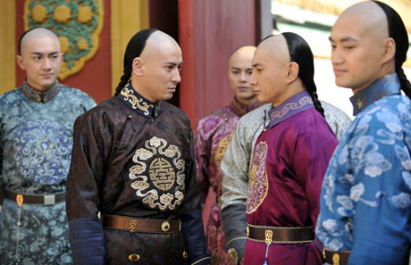
Manchu Hairstyle
Known for the queue hairstyle: shaved forehead with a long braid at the back
Initially a Manchu tradition, later enforced as a loyalty symbol under the Qing dynasty
Became a defining feature, blending cultural identity with political authority

Slide 4
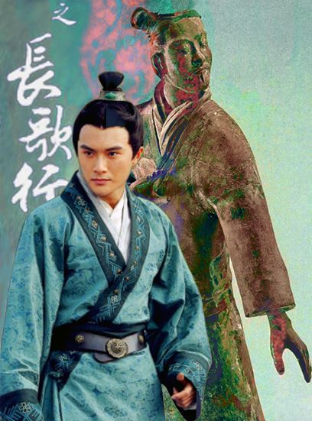
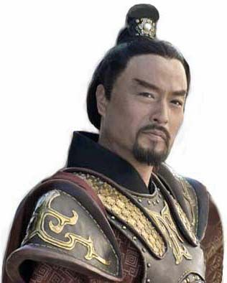
Politics of Hairstyles
Chinese Top Knot
Notes:
Traditional hairstyle, dates back to Antiquity. Linked to Confucian filial piety. Deeply associated with Chinese-ness, to shave the head indicated anti-social behavior, uncivilized, barbarian.

Slide 5
Lifestyle of the Manchus
Semi-Nomadic Life
Relied on hunting, fishing, and herding due to Manchurian environment
Practiced seasonal migrations for resource access
Fostered resilience, mobility, and adaptability
Community and Clan Structure
Organized into tribal communities led by clan chiefs
Strong kinship ties emphasized loyalty within clans
Clan-based governance essential for survival in harsh environments

Slide 6
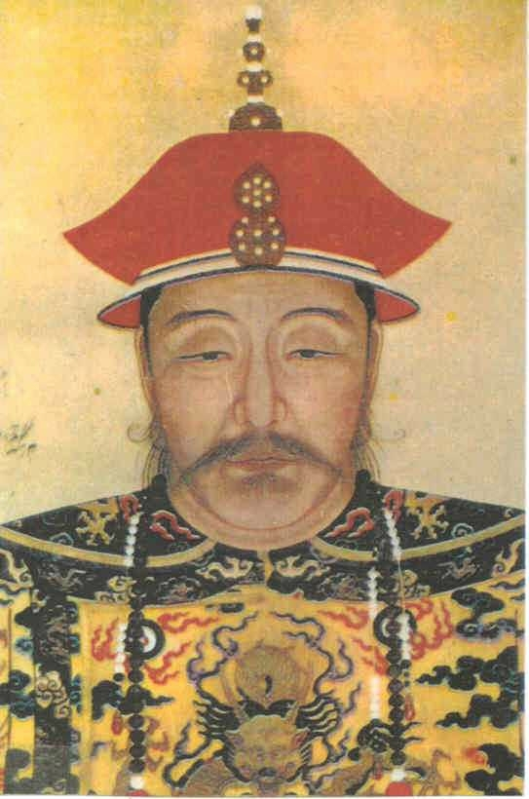
Nurhaci: Founder of the Later Jin Dynasty and the Rise of the Manchu

Slide 7
Nurhaci
Unification of Jurchen tribes
In 1616, declared himself Khan, founding the Later Jin Dynasty
Creation of Eight Banner System
divided the military into units based on "banners," each represented by a color (initially yellow, white, red, and blue) and later expanded to eight banners.
The banners were organized not only by military affiliation but also by ethnicity, with separate banners for Manchus, Mongols, and Han Chinese.
Conflict with the Ming
His forces began raiding northern Chinese territories, testing the defenses of the Ming.
successful campaigns against the Ming demonstrated the effectiveness of his military strategies and the Banner System.

Slide 8
Hong Taiji
Son and successor of Nurhaci
Renaming and Founding of the Qing (1636)
Expansion of the Banner System
Military Campaigns and Expansion
Hong Taiji led successful military campaigns against the Mongols, Korea, and the Ming Dynasty, solidifying control over northern China and preparing for the full conquest.
Cultural Adaption and Manchu Identity
Notes:
Hong Taiji (1592–1643) was a Manchu leader and the founding emperor of the Qing Dynasty, credited with transforming the political and military organization laid by his father, Nurhaci, into a formal state. His reforms strengthened the Manchu state and prepared it for the conquest of China.
Key Points about Hong Taiji:
Expansion of the Banner System:
Hong Taiji expanded the Banner System to include Mongol and Han banners, increasing the manpower and resources available to the Manchu state.
This integration of non-Manchu groups under the banner system helped maintain loyalty and control over newly conquered regions.
Political and Administrative Reforms:
Recognizing the need for a stable and organized government, Hong Taiji restructured the military-based organization into a functioning bureaucracy.
He founded the Six Ministries, modeled after Chinese administrative structures, which facilitated governance over an increasingly diverse population.
Renaming and Founding of the Qing Dynasty:
In 1636, Hong Taiji formally changed the name of his state from "Later Jin" to the Qing Dynasty, marking a shift in Manchu identity and a claim to rule over all of China.
This move symbolized the Manchu ambition to legitimize their rule as successors to the Ming Dynasty, and it appealed to both the Manchu and Han populations.
Military Campaigns and Expansion:
Hong Taiji led successful military campaigns against the Mongols, Korea, and the Ming Dynasty, solidifying control over northern China and preparing for the full conquest.
His strategic and diplomatic skills secured alliances that strengthened the Qing’s military position against the Ming.
Cultural Adaptation and Manchu Identity:
Hong Taiji adopted certain aspects of Chinese governance and Confucian ideals, recognizing their appeal to the Han Chinese majority.
However, he remained committed to preserving Manchu customs and values, ensuring a balance between integration and ethnic identity.
Hong Taiji’s contributions were foundational to the success of the Qing Dynasty, which would go on to become one of the largest and longest-ruling dynasties in Chinese history. His reforms and state-building efforts made the Qing a stable, centralized, and adaptable empire, setting the stage for its dominance over China.

Slide 9
Overthrow of the Ming
Ming collapses due to domestic problems and rebellion
Beijing falls to Li Zicheng in 1644
Ming General Wu Sangui
Stationed at Shanhaiguan (eastern terminus of Great Wall)
Allowed Manchus to pass
1644 Qing forces capture Beijing; proclaim they had come to punish rebels; claims to be legitimate successor
Buries deceased Ming emperor with full honors
Reestablishes Exam System
Reestablishes Traditional Chinese Government

Slide 10
Overthrow of the Ming
Forty years of bloody warfare to pacify rest China
Wu Sangui and other Chinese generals join forces with Manchus

Slide 11
Qing Legitimacy
Manchu’s comprised no more than 2% of population
Mandate does not require ethnic Chinese
How to maintain ethnic identity
Forbidden to intermarry
Maintained dress, family rituals, diet, & lifestyle
Manchu women forbidden from binding feet

Slide 12
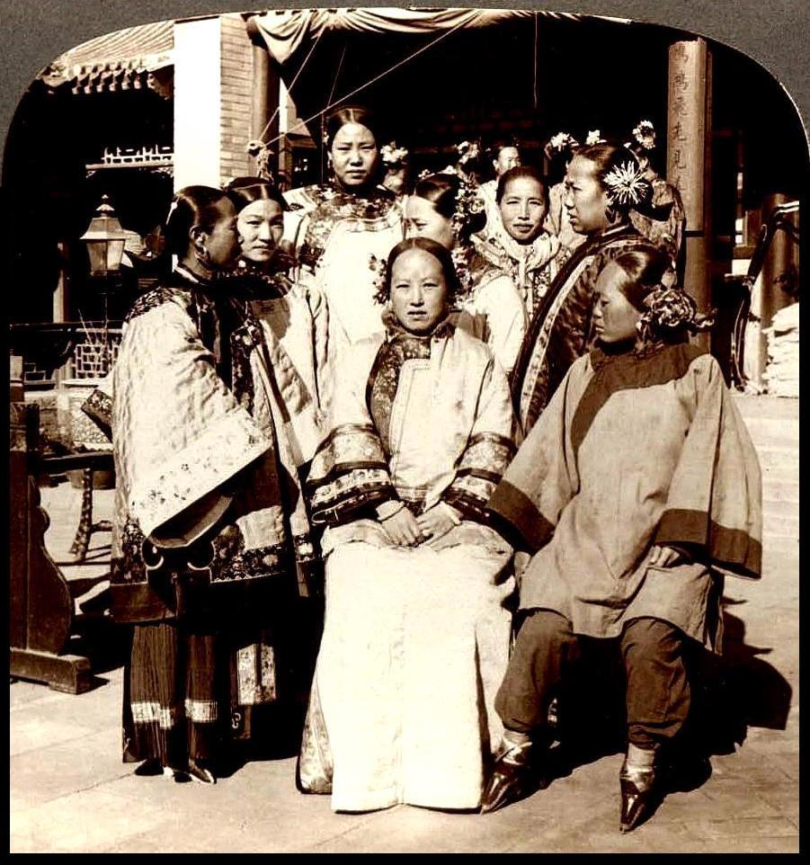
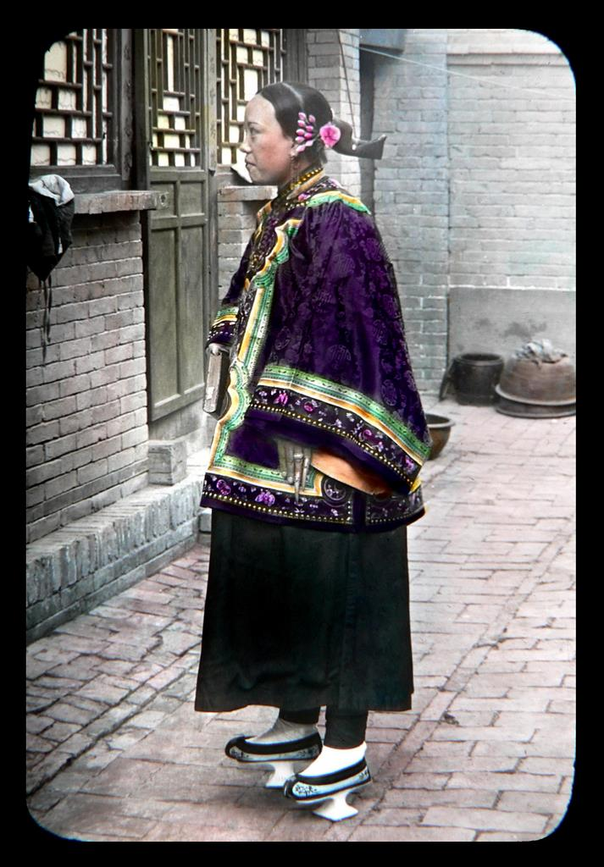
Manchu Women

Slide 13
Ming Loyalism: Resistance and Ideological Persistence
Military Resistance and Southern Ming Courts:
After the fall of Beijing, several members of the Ming royal family fled to southern China, where they established short-lived regimes known as the Southern Ming.
By the 1660s, Qing forces had effectively dismantled the Southern Ming strongholds
Koxinga
Prominent Ming loyalist and military leader who continued the fight against the Qing from Taiwan.
He established a base on the island, from which he launched raids against Qing forces and maintained a stronghold of Ming loyalism.
Although he passed away in 1662, Koxinga's followers held Taiwan until it fell to the Qing in 1683, symbolizing the resilience of Ming loyalist resistance.
Ideological and Cultural Loyalism
Express resistance through literature, art, and philosophy
Many scholars refused to serve the Qing
Notes:
Military Resistance and Southern Ming Courts:
After the fall of Beijing, several members of the Ming royal family fled to southern China, where they established short-lived regimes known as the Southern Ming.
These loyalist courts, including those led by Prince Fu, Prince Lu, and others, continued to resist Qing forces. However, internal conflicts, limited resources, and the superior Qing military made it difficult for these courts to survive.
By the 1660s, Qing forces had effectively dismantled the Southern Ming strongholds, but isolated military resistance continued sporadically.
The Role of Koxinga:
Zheng Chenggong, known as Koxinga, was a prominent Ming loyalist and military leader who continued the fight against the Qing from Taiwan.
He established a base on the island, from which he launched raids against Qing forces and maintained a stronghold of Ming loyalism.
Although he passed away in 1662, Koxinga's followers held Taiwan until it fell to the Qing in 1683, symbolizing the resilience of Ming loyalist resistance.
Ideological and Cultural Loyalism:
Ming loyalism was not only a military movement but also a cultural and ideological one. Scholars, poets, and artists who remained loyal to the Ming expressed their resistance through literature, art, and philosophy.
Many scholars refused to serve the Qing, choosing instead to live as recluses or to write about Ming virtues and critiques of the new regime. Works subtly promoting Ming values and Confucian ideals flourished during this period.
Loyalists often used coded language, symbols, and themes to avoid Qing censorship, emphasizing their commitment to Ming ideals and disdain for Qing rule.
Symbolism and Cultural Resistance:
Ming loyalists maintained loyalty symbols in clothing, rituals, and even landscape paintings. For instance, some loyalists continued wearing Ming-style clothing as a quiet act of resistance.
Cultural artifacts, such as Ming-era portraits, family shrines, and rituals, helped maintain the Ming identity within Qing-ruled China, especially in the southern provinces where loyalist sentiments were strongest.
Legacy of Ming Loyalism:
Although the Qing eventually consolidated power, Ming loyalism left a lasting cultural impact. It preserved traditional Confucian values and practices during the early Qing period and laid a foundation for later anti-Manchu sentiment.
The memory of Ming loyalism contributed to future nationalist and anti-foreign sentiments, especially in the late 19th and early 20th centuries, as Chinese intellectuals sought to revive Han Chinese identity.
Ming loyalism also influenced the cultural landscape, as many later Qing scholars and officials drew inspiration from the courage and dedication of Ming loyalists, even though they ultimately served the Qing.
Ming loyalism after 1644 represented a complex blend of military, cultural, and ideological resistance. While the movement was ultimately unable to restore the Ming Dynasty, it kept the spirit of Ming ideals alive and challenged the legitimacy of the Qing, leaving an enduring legacy in Chinese history.

Slide 14
The Qing Dynasty at its Height

Slide 15
The Qing at its Height
Effective Monarchs
Population growth (Doubled during 18th Century)
Global warming extended growing season
Slowing of new diseases
Famine relief
Introduction of New World Crops to China
Solves famines, increases population – however,
Leads to deforestation, flooding, and rebellion
Destabilizes dynasty, making it vulnerable to European encroachment

Slide 16
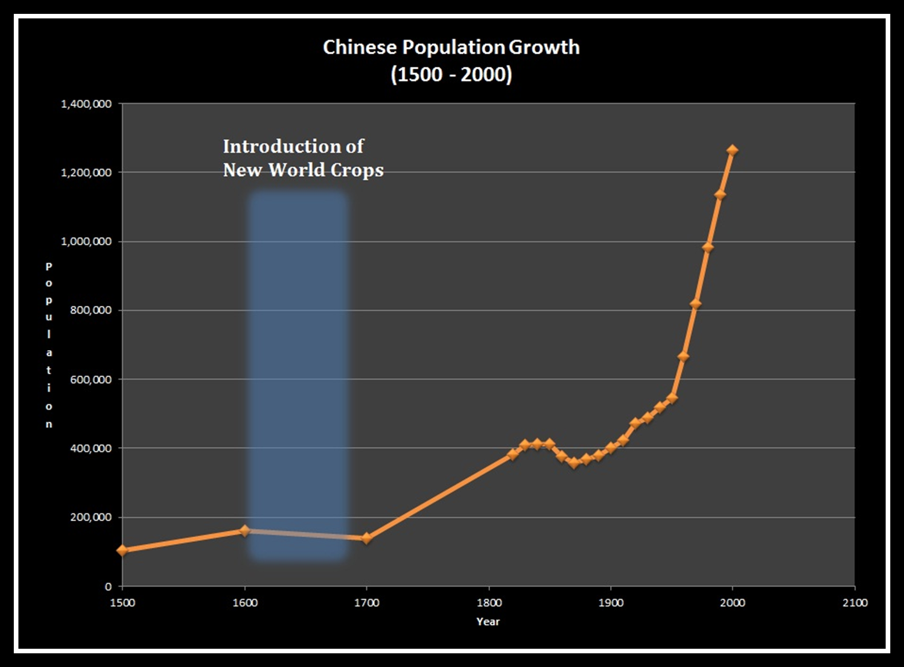

Slide 17
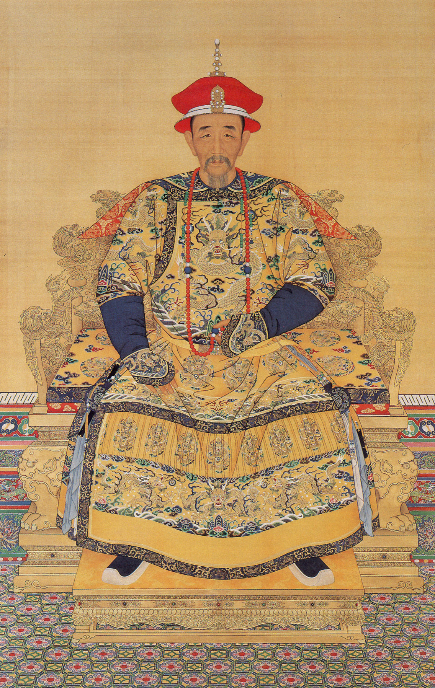
The Kangxi Emperor
Ascended throne at age 7, took direct control at age 14
Strengthened Central Control
Territorial Expansion and Military Campaigns
Led several military campaigns to expand Qing territory
Subdued Ming loyalist rebellions
Defeated Koxinga’s descendants, brought Taiwan under Qing control
Led campaigns into Outer Mongolia, Tibet, and Central Asia

Slide 18
The Kangxi Emperor
Relations with Russia
Destroyed Russian Cossack Base
The Treaty of Nerchinsk (1689) with Russia established clear borders between the two empires.
This treaty marked one of the earliest instances of diplomacy between China and a European power and allowed the Qing to focus on securing its northern borders.

Slide 19
Reign of Kangxi
Very much Manchu; but not anti-Chinese
Closed Manchuria to Chinese immigration
Maintained balance between Manchu and Chinese
Worked to attract Ming loyalists

Slide 20
Reign of Kangxi
Vigorous Man and Effective ruler
Rose before dawn each day
Wide intellectual interests
Patronized arts and sponsors intellectual projects
Special support to philosophy of Zhu Xi

Slide 21
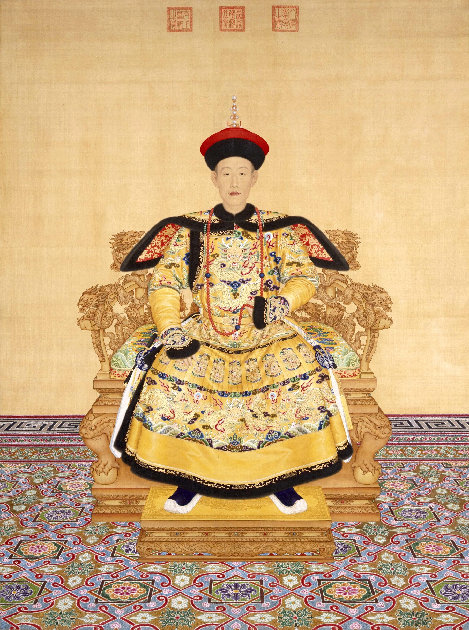
Qianlong
Achieved greatest prosperity and expansion
Qing Expansion
Divide and rule policies
Ability to work with Inner Asian leaders and symbols of authority
Declining strength of Inner Asian peoples
Notes:
Dynasty’s most splendid reign.

Slide 22
Qing Expansion
Incorporated Chinese Turkestan (Xinjiang)
Conquered Ili in the West
Dominated Outer Mongolia & Tibet
Fought two bloody wars against Tibetan minority
Involved millions of square miles and as far away as Burma, Vietnam, and Nepal creating a multi-ethnic empire
Notes:
Dynasty’s most splendid reign.
Map on p. 264

Slide 23
Qing Expansion
To foster loyalty among Mongols and Tibetans drew on Buddhist tradition
Six Tangkas portray him as Manjusri

Slide 24
The Emperor’s Paradise
Unprecedented prosperity; Qianlong riches man in world
Patronage of scholarship but suspicious of anti-Manchu writings
Complete Library of Four Treasuries
3462 complete works in 36,000 volumes
Suppressed anti-Manchu writings
80% officials were Chinese; but required Manchus to retain ethnic identity
Notes:
Compilation of Manchu history and genealogies; study and use of Manchu language; all customs that set Manchu apart from Chinese such as dress, ear-rings, etc. Manchu women forbidden to bind feet.

Slide 25
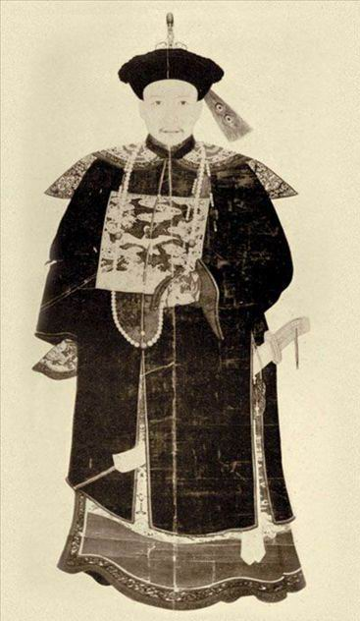
Corruption
Heshen (1750-1799) gained favor of Qianlong emperor
Received highest ministerial positions in empire
Systematic embezzlement
Lined his own pockets with money allocated to suppress rebellion
Removed only after the death of the Qianlong emperor, having amassed a vast fortune

Slide 26
Banner System
Structure
Each banner was a self-sufficient unit with administrative, military, and social hierarchies.
Three branches for Manchu, Mongol, and Han Chinese banners.
Each banner led by a commander reporting directly to the emperor.
Role in the Qing
Main military force, active in campaigns and border defense.
Banner families received land, housing, and stipends, ensuring privilege.
Integrated various ethnic groups into banner structure for oversight.

Slide 27
Banner System and Ethnic Integration
Incorporation of Mongols and Han Chinese:
Prevented unified opposition through separate banners.
Cultural and Social Impact:
Maintained a social hierarchy with Manchu elite at the top.
Promotion of Manchu Identity:
Preserved Manchu customs and practices within a multi-ethnic empire.

Slide 28
Decline of the Banner System
Economic Strains:
Financially unsustainable support for banner families and military upkeep.
Reduced Military Efficiency:
Banner troops lost effectiveness over time.
Role in Rebellions:
Struggled during uprisings like the Taiping Rebellion, revealing system weaknesses.

Slide 29
Contacts with Europe

Slide 30
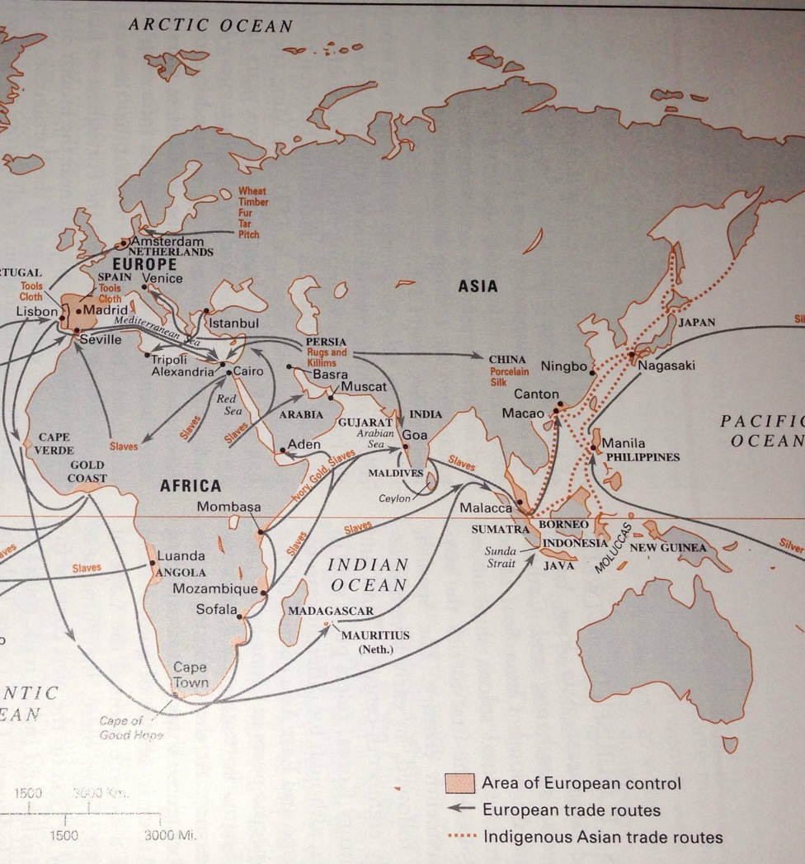
The Portuguese in East Asia
Establish Asian headquarters at Goa in 1510; captured Malacca in 1511
Desire to break the Arab spice monopoly
No European commodities of equal value (later new world silver come from Spanish) – Portuguese become shippers
“ocean devils” – new barbarian that eats children
1557 Portuguese allowed to establish on Maco; 1887 Macao officially ceded to Portugal

Slide 31
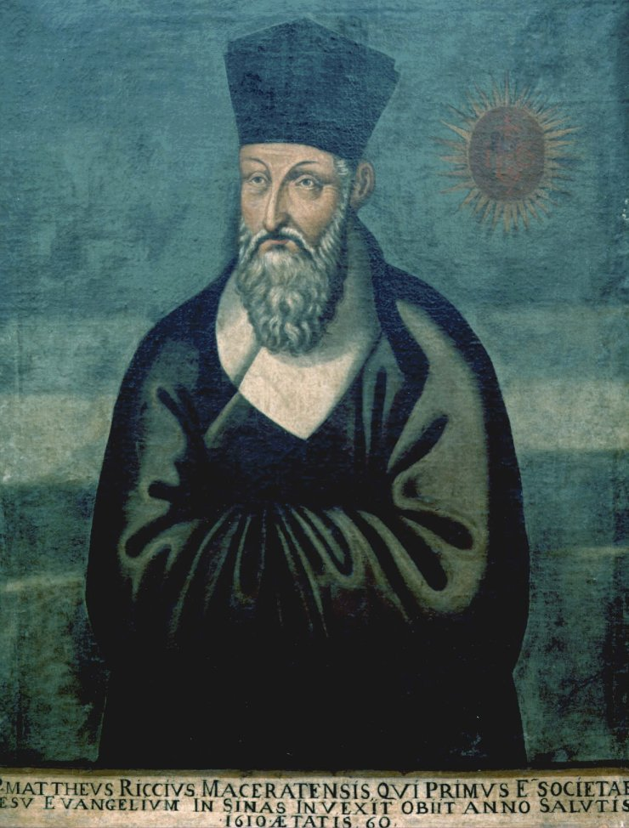
Jesuits in China
Matteo Ricci resides in Beijing in 1601
Polymath; Chinese impressed with knowledge
Adopted Confucian garb
Adam Schall von Bell
Trained astronomer served as chief government astronomer
Jesuits served at Court as astronomers and cartographers

Slide 32
Rights Controversy
Are ancestor rites secular or religious?
Dominicans and Franciscan argue with Jesuits over Ancestral Altars
Jesuits argue that ancestor rites are secular and not incompatible with Christianity
Pope issues edict forbidding ancestor worship by Chinese Christians
Kangxi Emperor Outlawed Christianity and expelled missionaries

Slide 33
Canton System
Foreign merchants restricted to Canton
Warehouse (factories) set aside for foreign use
Families not permitted
Limited to Cohong (association of firms)
No access to Chinese government or direct government to government relations
British East India Company
Monopoly of trade between England and China
Agent of British imperialism

Slide 34
Macartney Mission
Imbalance of trade; merchants dissatisfied with restrictions
King George sends Lord George Macartney to negotiate with the Qing Emperor
Secure place for British near tea producing areas
Negotiate a commercial treaty
Create a desire for British goods
Arrange for diplomatic representation in Beijing

Slide 35
Macartney Mission
Imbalance of trade; merchants dissatisfied with restrictions
King George sends Lord George Macartney to negotiate with the Qing Emperor
Macartney refuses to Kaotao; allowed informal meeting with the Qianlong emperor
No formal negotiations followed; China had no desire to alter terms of trade
Members of embassy return and write about China

Slide 36
Social and Cultural Crosscurrents

Slide 37
Conservative Turn
Wang Yangming undermined commitment to duty and respect for authority
Call for return to Zhu Xi’s teachings
Prostitution, homosexuality, and the theatre proscribed
Cult of Widow Chastity
“It would be better for a widow to starve to death rather than to remarry”
Cheng Yi

Slide 38
Eight Eccentrics of Yangzhou
Group of 8 painters who rejected convention, personally and artistically
Ink painting for self-expression; individual style
Often sold art for money

Slide 39
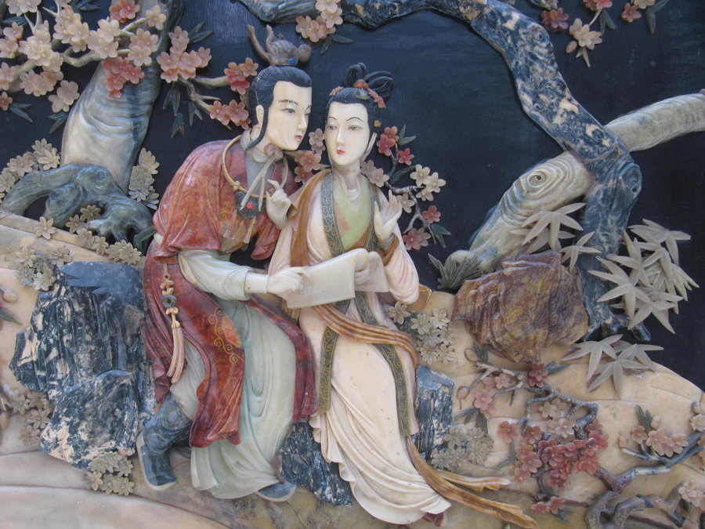

The Dream of the Red Mansions
Notes:
http://www.npr.org/2012/07/15/156143707/in-red-chamber-a-love-triangle-for-the-ages

Slide 40
The Less Advantaged and the Disaffected

Slide 41
Open Villages
Villages held no land in common; land could be bought and sold freely
Impoverished peasants forced to sell land; men, women, and children forced to do sideline work
Single-surname villages
Villages connected through marriages and markets
No legal status distinctions; but discrimination persisted
Discrimination against Boat People, certain occupations, and ethnic minorities
Village life disrupted by drought and floods
Notes:
Lecture Notes: Open Villages of the Qing Dynasty (Expanded with Uploaded Content)
I. Villages Held No Land in Common
Unlike traditional communal landholding systems, Qing villages operated on a private landownership model.
Land Bought and Sold Freely:
Wealth disparities emerged as impoverished peasants often had to sell their land.
This forced many to work as tenant farmers or laborers in other sectors.
Sideline Work:
To survive, entire families, including men, women, and children, engaged in additional income-generating activities such as weaving, crafting, or working in nearby towns.
II. Single-Surname Villages
Many Qing villages were dominated by a single family or clan, sharing a common surname.
These villages often operated as tight-knit communities with strong familial bonds, which facilitated cooperation and collective decision-making.
Advantages:
Clan solidarity provided support during economic hardships.
Disputes were resolved internally, reducing reliance on external authorities.
III. Villages Connected Through Marriages and Markets
Marriages served as a tool to create alliances between families and neighboring villages.
Markets:
Local markets were central to the economic life of villages, allowing the exchange of goods and services.
These networks connected rural areas with larger towns and cities, integrating villages into broader regional economies.
IV. No Legal Status Distinctions, But Social Discrimination Persisted
In theory, Qing law did not distinguish between villagers based on social status or occupation.
Social Discrimination:
In practice, groups such as the Boat People (a marginalized community living on water), certain occupational groups (e.g., butchers, entertainers), and ethnic minorities faced discrimination.
These groups were often excluded from landownership and faced social stigmatization.
V. Vulnerability to Natural Disasters
Drought and Floods:
Qing villages were frequently affected by natural calamities like droughts and floods, which disrupted agricultural production.
These events could lead to famine, forcing peasants to migrate or rebel against local authorities.
Local governance played a key role in organizing relief efforts, but widespread disasters often exceeded their capacity.
Conclusion:
Open villages in the Qing Dynasty illustrate the complexities of rural life, highlighting economic inequalities, social organization, and resilience in the face of environmental challenges. Despite their challenges, these villages were vital to the Qing’s administrative and economic system, sustaining the empire's agrarian foundation.

Slide 42
Societal Challenges and Brotherhoods in Qing Villages
Shortage of marriageable women
Concubinage
Sex-selective infanticide
Single men abandon village to seek work
Often found support in Brotherhoods
Heaven and Earth Society (Triads)
Security, mutual aid, and empowerment
Anti-establishment
Organized crime and gambling
Notes:
I. Shortage of Marriageable Women
Demographic Imbalance:
During the Qing Dynasty, many villages experienced a shortage of marriageable women, leading to significant social challenges.
This imbalance was partly due to practices like concubinage, where wealthy men took multiple wives or concubines, leaving fewer women available for poorer men.
Sex-Selective Infanticide:
Cultural preferences for male heirs led to sex-selective infanticide, where female infants were disproportionately abandoned or killed.
This practice further exacerbated the gender imbalance, especially in rural areas.
II. Migration of Single Men
Economic Migration:
Single men, unable to marry or support a family within their village, often left to seek work in cities, mines, or on large estates.
These migrations disrupted village communities, as younger, more able-bodied men left, affecting local labor and social structures.
Urban Challenges:
In urban areas, these men often faced difficult living conditions and limited opportunities, making them vulnerable to exploitation and hardship.
III. Brotherhoods as Support Networks
Formation of Brotherhoods:
Many displaced men found support in Brotherhoods, such as the Heaven and Earth Society (Triads).
These organizations offered a sense of belonging, providing security, mutual aid, and empowerment.
Anti-Establishment and Resistance:
Brotherhoods often harbored anti-establishment sentiments, seeing themselves as protectors of justice and defenders of the disenfranchised.
They resisted Qing authority and sometimes engaged in rebellious activities.
Involvement in Organized Crime:
Over time, some brotherhoods became involved in organized crime, including gambling, smuggling, and other illicit activities.
This dual nature allowed them to wield considerable power in certain regions, both as protectors and as criminal enterprises.
IV. Social and Political Impact
The shortage of marriageable women and the rise of brotherhoods highlighted broader societal challenges during the Qing Dynasty, including economic inequality, migration, and resistance to state authority.
Brotherhoods became both a social safety net and a source of instability, influencing local governance and Qing policy in rural and urban areas.
Conclusion:
The demographic and social pressures in Qing villages shaped a complex network of support and resistance. While brotherhoods provided critical assistance to marginalized men, their involvement in anti-establishment activities and crime posed challenges for Qing rule, contributing to the social dynamics of the time.
4o

Slide 43
White Lotus Society
Syncretic movement (Buddhism, Daoism, and Manichaeism)
Central deity Wusheng Laomu (Eternal Mother)
Salvation through faith and mantra
Correct flow of qi to cure illness and promote health
Millenarianism
Maitreya Buddha
Women welcomed as equal members
Strict vegetarianism
Notes:
I. Syncretic Religious Movement
Definition of Syncretism:
The White Lotus Society was a syncretic movement that blended elements of Buddhism, Daoism, and Manichaeism.
This combination appealed to a broad range of followers by addressing spiritual, physical, and societal concerns.
Core Beliefs:
Borrowed from Buddhist ideas of salvation and enlightenment.
Integrated Daoist practices, emphasizing harmony and health through the flow of qi.
Adopted Manichaean dualism, emphasizing a cosmic battle between forces of good and evil.
II. Central Deity: Wusheng Laomu (Eternal Mother)
Role of Wusheng Laomu:
The Eternal Mother was the spiritual focus, believed to offer salvation to her followers.
She was viewed as a protective figure guiding her children back to a paradisiacal realm.
Spiritual Practices:
Salvation through faith and mantra:
Followers believed that reciting mantras dedicated to Wusheng Laomu could lead to spiritual salvation.
Qi and Healing:
Emphasis was placed on maintaining the correct flow of qi to promote physical health and cure illnesses, blending spiritual and practical well-being.
III. Millenarian Beliefs
Millenarianism:
The White Lotus Society promoted millenarian ideas, prophesying the imminent arrival of a new age where suffering and injustice would end.
Role of Maitreya Buddha:
The group believed in the coming of Maitreya, the future Buddha, who would usher in a utopian era of peace and prosperity.
IV. Role of Women in the Movement
Equality for Women:
Unlike many contemporary religious and social movements, the White Lotus Society welcomed women as equal members.
Women actively participated in religious rituals and leadership, which was particularly appealing in a patriarchal society.
V. Lifestyle Practices: Strict Vegetarianism
Dietary Discipline:
Followers adhered to strict vegetarianism, which was both a spiritual practice and a way to demonstrate purity and discipline.
This lifestyle symbolized non-violence and respect for life, aligning with their broader religious values.
VI. Social and Political Implications
Resistance to Qing Rule:
The White Lotus Society was often associated with anti-establishment activities, including uprisings against the Qing government.
Their millenarian beliefs inspired hope and resistance among marginalized communities, making them a significant force in rural rebellions.
The White Lotus Rebellion (1796–1804):
One of the most notable uprisings linked to this movement, where followers rebelled against heavy taxation and government corruption.
Although the rebellion was ultimately suppressed, it marked a significant challenge to Qing authority.
Conclusion:
The White Lotus Society combined spiritual, social, and political elements, offering a vision of salvation and justice that resonated with many during the Qing era. Its syncretic beliefs and practices, particularly its inclusion of women and millenarian hopes, made it both a religious sanctuary and a symbol of resistance against oppressive rule.
4o

Slide 44
White Lotus Rebellion (1796–1804)
Causes
Qing investigations in 1793 heightened tensions
Peasant grievances: heavy taxation, corruption, land shortages
Outbreak and Spread
Revolt began in Hubei (1796) and spread across central China
Rebels joined by martial arts groups and bandits
Guerrilla tactics posed challenges for Qing forces
Notes:
White Lotus Rebellion (1796–1804)
Origins and Causes
Religious movement with millenarian beliefs
Qing investigations in 1793 heightened tensions
Peasant grievances: heavy taxation, corruption, land shortages
Outbreak and Spread
Revolt began in Hubei (1796) and spread across central China
Rebels joined by martial arts groups and bandits
Guerrilla tactics posed challenges for Qing forces
Qing Response and Consequences
Took Qing forces 8 years to suppress the rebellion
Conflict wiped out the imperial treasury
Exposed weaknesses in Qing military and administration
Legacy
Marked the beginning of Qing decline
Precursor to later uprisings like the Taiping Rebellion
You can copy and paste this content into your own presentation. Let me know if you need further assistance!
4o

Slide 45
White Lotus Rebellion (1796–1804)
Qing Response and Consequences
Took Qing forces 8 years to suppress the rebellion
Conflict wiped out the imperial treasury
Exposed weaknesses in Qing military and administration
Legacy
Marked the beginning of Qing decline
Precursor to later uprisings like the Taiping Rebellion
Notes:
White Lotus Rebellion (1796–1804)
Origins and Causes
Religious movement with millenarian beliefs
Qing investigations in 1793 heightened tensions
Peasant grievances: heavy taxation, corruption, land shortages
Outbreak and Spread
Revolt began in Hubei (1796) and spread across central China
Rebels joined by martial arts groups and bandits
Guerrilla tactics posed challenges for Qing forces
Qing Response and Consequences
Took Qing forces 8 years to suppress the rebellion
Conflict wiped out the imperial treasury
Exposed weaknesses in Qing military and administration
Legacy
Marked the beginning of Qing decline
Precursor to later uprisings like the Taiping Rebellion
You can copy and paste this content into your own presentation. Let me know if you need further assistance!
4o

