Slide 1
China Among Equals: Song, Liao, Xia, and Jin
Chapter 8

Slide 2
The Founding of the Song Dynasty
Founded by general of last of the five dynasties
How to prevent decentralization
  Encouraged generals to retire
  Frequent rotation of troops
  Frequent change in command
Military suffers permanent loss of status
Notes:
2
Zhao Kuangyin was a general placed on throne by his soldiers. Took steps to see that army would not be able to do this again. Retired or rotated his own generals; assigned civil officials to supervise generals.

Slide 3
Toleration of non-Chinese presence
Liao Dynasty founded by Khitan
  Occupied 16 prefectures on Chinese side of Great Wall
  Treaty of 1005 provided for cession of territory back to Song; Song sent Liao contributions of silk and silver (“bought off”)
Tribute was humiliating but cheaper

Slide 4
Song’s Rivals: Liao
Khitan were a proto-Mongol people
Abaoji (d. 926) unites several Khitan tribes and dominates the steppe
Sets aside traditional Khitan practice and instituted hereditary succession
Dual Government
  Southern section governed on the basis of Chinese traditions
    Khitan imperial relatives granted fiefs
  Northern Section allowed Khitans to maintain tribal organization and resist sinification

Slide 5
Origins of the Tangut People
The Tanguts were a nomadic people from the Tibetan plateau.
They migrated to northern Shaanxi and Gansu due to pressure from Tibet.
By the 9th century, they gained control of trade routes and consolidated power.

Slide 6
Rise of Xi Xia
Under Li Yuanhao (r. 1032–1048),
  Created a federation of tribes; Xi Xia declared sovereignty.
Yuanhao demanded recognition from the Song Dynasty.
The Tangut state became fully established as Xi Xia.
Notes:
Li Yuanhao and the Founding of Xi Xia (Western Xia)
Ethnic Identity: Tangut, Not Chinese
Li Yuanhao (李元昊, r. 1038–1048) was ethnically Tangut — a people who called themselves Minyak or Dangxiang in Chinese sources. The Tangut were a Tibeto-Burman speaking people, linguistically and culturally distinct from Han Chinese, though they had been neighbors (and sometimes subjects) of Chinese states for centuries.
The surname Li is the giveaway that things are complicated. His family had been granted the imperial Chinese surname Li by the Tang court as a mark of favor — the same Li as the Tang imperial house. Later, the Song continued recognizing his family with the surname Zhao (the Song imperial surname). So his Chinese name was essentially a diplomatic artifact, a badge of political clienthood, not an ethnic marker.
Li Yuanhao himself dramatically rejected this when he proclaimed the Xi Xia empire in 1038. He:
Dropped the Chinese surname and insisted on the Tangut name Weiming Yuanhao
Declared himself Heavenly Prideful Emperor (Tian Jiao Di), using the full imperial title vocabulary rather than the subordinate "king" title the Song expected
Commissioned a Tangut script (one of the great writing systems of medieval Asia) to give his people a distinct written identity
Ordered Tangut men to shave the tops of their heads in the traditional Tangut style rather than wearing hair in the Chinese manner — and gave a grace period after which resistance would be punishable by death
This was a deliberately anti-assimilationist program. He was asserting that the Tangut were not a peripheral Chinese dependency but a coequal civilization.
Background and Rise
The Tangut Dangxiang had drifted into the Ordos region (the great bend of the Yellow River) and the Gansu corridor over several centuries, originally as semi-nomadic pastoralists. Li Yuanhao's great-grandfather Li Jiqian had begun the transformation from tribal chieftain to regional warlord in the late 10th century, playing the Liao (Khitan) and Song courts against each other with great skill.
Li Yuanhao inherited a fully militarized state from his father Li Deming, but Deming had remained formally deferential to Song — accepting titles, receiving silk payments (a kind of tribute in reverse dressed up as "gifts"), and not pushing for full sovereignty. Li Yuanhao found this humiliating and moved aggressively:
Military consolidation — he crushed the Ganzhou Uyghur kingdom to his west and expanded toward Dunhuang and the Hexi Corridor, giving Xi Xia control of the Silk Road trade routes
Political rupture with Song — he sent the Song court a letter essentially announcing his imperial status; the letter's arrogant tone reportedly scandalized the Song bureaucracy
Military pressure — Xi Xia armies badly defeated Song forces at the battles of Sanbchuan'kou (1041) and Haoshuichuan (1042), exposing Song military weakness
The Settlement and Its Meaning
Eventually (1044), the Song and Xi Xia reached a compromise: Song would not formally recognize Li Yuanhao's imperial title in Chinese diplomatic correspondence, but in practice would pay him annual "gifts" of silk, silver, and tea (essentially tribute) and he would accept a nominal "king" title in Song documents. Both sides could claim face.
This is a pattern you see repeatedly in the Song period — the "China among equals" problem that your Chapter 8 textbook addresses. The Song possessed enormous economic and cultural resources but persistent military weakness against steppe and semi-steppe neighbors, leading to these face-saving diplomatic fictions.
Why This Matters Historiographically
Li Yuanhao is a fascinating case for the sinicization debate. Xi Xia was deeply bicultural:
They used Chinese administrative models, Chinese Buddhism flourished, Chinese merchants filled their cities
Yet the Tangut script, Tangut law codes, and Tangut Buddhism (with strong Tibetan influence) remained vigorous
Li Yuanhao himself is evidence that proximity to Chinese culture did not mean absorption into it — he knew the Chinese system intimately and chose differentiation as a political strategy
The Xi Xia state lasted until 1227, when Chinggis Khan — reportedly on his deathbed — ordered its total destruction, and the Mongols carried out one of the most thorough acts of deliberate annihilation in medieval history. The Tangut people as a distinct political and cultural entity essentially ceased to exist. What we know of them comes largely from manuscripts discovered at Khara-Khoto, excavated by Pyotr Kozlov in 1908–09 and now mostly in St. Petersburg.
If you're developing lecture material on Chapter 8 (Song / China Among Equals), Li Yuanhao and Xi Xia would make an excellent case study for the lecture on frontier states and the limits of Chinese cultural gravity. Want me to pull the relevant chapter from your textbook to see how it frames Xi Xia?

Slide 7
Xi Xia’s Political Structure and Governance
Blended elements from Tang, Song, Liao, Uighur, and Tibetan models.
Confucian statecraft mixed with a strong Buddhist religious foundation.
A unique Tangut script was developed to preserve cultural identity.

Slide 8
Relations with the Song Dynasty
Initial conflicts between Xi Xia and the Song.
The 1044 Treaty: Song agreed to annual payments to Xi Xia.
Tanguts saw the payments as a recognition of sovereignty.

Slide 9
A New Era
Notes:
9
The pace of change was rapid from the late Tang into the early Song period, and by the mid-eleventh century, China in many ways was a much more modern society, with cities and commerce transforming its economy and printing and examinations transforming elite culture.

Slide 10
The Medieval Chinese Economic Revolution: Agriculture
Population Growth and Agricultural Advancements
  50 million to 100 million bv 1102
  Expansion of rice cultivation and multiple harvest
Commercialization of agriculture
  Commercial crops
  Surplus and Trade
  Stimulates transportation and shipping industries
Demand for money grows –
  Copper coins
  worlds first paper money
  Government issued paper currency
Notes:
Population Growth and Agricultural Advancements
In 742, China's population was approximately 50 million, a number slightly lower than what it had been centuries earlier in 2 C.E. However, by 1102, China’s population had doubled to 100 million.
Agricultural Expansion: The population boom was made possible by the expansion of rice cultivation in central and southern China. The development of rice farming, particularly in the fertile Yangzi River region, increased food supply significantly.
Multiple Harvests: The milder climate in southern China allowed two rice crops per year, further enhancing agricultural productivity.
This agricultural abundance sustained a larger population, and with denser settlements came increased commercialization of the economy.
2. The Commercialization of Agriculture
With a growing food supply, many farmers shifted from subsistence farming to producing goods for the market:
Commercial Crops: Instead of only growing food for themselves, farmers began cultivating commercial crops such as sugar, oranges, cotton, silk, and tea. This transition marked the end of self-sufficiency for many peasant households.
Surplus and Trade: Farmers in densely populated areas sold their surpluses in nearby markets, where they could purchase charcoal, tea, oil, and wine.
Shipping and Trade Networks: The demand for transportation to move these goods spurred the growth of inland and coastal shipping industries, which created jobs for shipbuilders and sailors.
Venetian explorer Marco Polo marveled at the bustling traffic on the Yangzi River, claiming to have seen over 15,000 vessels docked at one city alone. This level of trade was unprecedented in Europe at the time.
3. The Emergence of Paper Money
As commerce expanded, the demand for currency surged, and China pioneered a groundbreaking financial innovation:
Copper Coins: By the mid-Song period, copper coins were widely circulated, with output reaching over 6 billion coins per year by 1085, ten times the amount minted during the Tang Dynasty.
Early Paper Money: To avoid the inconvenience of carrying large quantities of coins, merchants began using receipts from deposit shops to conduct large transactions.
Government-Issued Paper Money: In the 1120s, the Song government took over the issuance of these certificates, producing the world’s first government-issued paper money. This system revolutionized trade by allowing easier and more secure large-scale transactions.
4.

Slide 11
The Medieval Chinese Economic Revolution: Industry
Industrial Growth and Technological Advancements
  Iron Production
  Coke and Metallurgy
  Mass Production
  Gun Powder
Growth of Commerce and Urbanization
  Great Cities – Kaifeng and Hangzhou
  Guilds and Specialization
  Abolition of Curfew
Notes:
Industrial Growth and Technological Advancements
The Song Dynasty witnessed tremendous advances in industrial production, particularly in iron manufacturing and metallurgy:
Iron Production: By 1078, China was producing around 125,000 tons of iron annually, a sixfold increase since the early 9th century. This expansion was driven by both civilian demand and military needs.
Coke and Metallurgy: The switch from charcoal to bituminous coke as the primary fuel for smelting iron helped reduce deforestation and improved efficiency in iron production.
Mass Production: Iron was used to produce weapons, armor, and tools at an industrial scale, with mass-production techniques employed to create standardized products like iron armor and steel swords.
Gunpowder: Chinese engineers also began experimenting with gunpowder, initially using it to propel projectiles in warfare, particularly against the Jurchen invasions in the 12th century.
5. The Growth of Commerce and Urbanization
The commercialization of the economy contributed to the rapid growth of cities during the Song Dynasty:
Great Cities: Cities such as Kaifeng and Hangzhou flourished as centers of commerce and industry. Kaifeng, located near the Grand Canal, became one of the most economically vibrant cities of the Song era.
Guilds and Specialization: Merchants became increasingly organized, forming guilds based on their products. These guilds regulated prices, coordinated sales, and negotiated with the government on issues such as taxation and requisitioning.
Abolition of the Curfew: In 1063, the curfew in Kaifeng was abolished, allowing businesses in entertainment districts to remain open all night, creating a bustling urban environment.
6. The Shift to the South: The Yangzi River as the Economic Heart
A significant result of the economic revolution was the shift of China’s economic center to the south, particularly to the Yangzi River region:
Rice Agriculture: Rice, which provided more calories per acre than wheat or millet, allowed for denser populations in the southern regions.
Shipping and Transportation: The abundance of rivers and waterways in the south made it cheaper and easier to transport goods, stimulating regional specialization and commercial development.
Yangzi River: This region became the economic heart of China during the Song Dynasty, a role it would continue to play in the centuries that followed.

Slide 12
International Trade
Trade connected all states in region
Stimulated by indemnities paid by Song
Trade goods included:
  China exported tea, silk, coins, paper and books, porcelain, spices, etc.
  China imported silver, horses, cotton cloths, gems, and perfumes
Maritime trade exceeds overland trade

Slide 13
Growth of the Scholar-Official Class
Expansion of the Educated Class and the Role of Printing
The Civil Service Examination
  Increased participation
  Multiple Attempts
  Meritocracy vs. Privilege
    40% of posts were still filled by nominations
Social Mobility
Notes:
During the Song period, the scholar-official class expanded dramatically compared to earlier dynasties, particularly the Tang Dynasty.
Civil Service Examinations: The Song civil service examination system was one of the most competitive in the world, certifying scholars based on their knowledge of Confucian classics, history, poetry, and policy. The examinations were meant to select men who were literate, intelligent, hardworking, and obedient.
Merit and Objectivity: To ensure fairness, the Song Dynasty implemented reforms that anonymized candidates’ names by replacing them with numbers. Additionally, clerks recopied the exams to obscure handwriting, thus reducing favoritism.
Jinshi Degree: The most prestigious degree was the jinshi (presented scholar). The number of men who earned this degree during the Song was four to five times greater than during the Tang. Despite this, the prestige of the degree remained high, and more men than ever competed for these positions.
2. Expansion of the Educated Class and the Role of Printing
One of the key factors that contributed to the expansion of the scholar-official class was the development of printing technology.
Affordable Books: Printing made books more affordable, allowing scholars to amass large collections. This availability of books helped cultivate a more educated class of officials, as they had access to texts on Confucianism, history, philosophy, and even Buddhist scriptures.
Spread of Knowledge: With cheaper books, the demand for knowledge exploded. Works on science, medicine, philosophy, and history were widely circulated. This intellectual ferment contributed to the flourishing of Song intellectual life and culture.
3. The Civil Service Examination System
The Song examination system became a central feature of Chinese bureaucracy:
Increased Participation: Early in the Song period, around 30,000 men took the prefectural exams. By the end of the 11th century, that number had grown to 80,000 and reached around 400,000 by the end of the dynasty. Despite this increase, the chances of passing were slim, sometimes as low as 1 in 333.
Multiple Attempts: Many scholars took the exams multiple times before succeeding, with the average successful candidate being in his thirties.
Meritocracy vs. Privilege: While many officials earned their positions through the exams, 40% of posts were filled through nominations by higher-ranking officials. Sons and grandsons of officials could take advantage of this privilege, although they often had to start in lower-level positions.
4. The Scholar-Official Class and Social Mobility
The examination system did foster some degree of social mobility, but it was not without its limitations.
Meritocratic Aspirations: Scholars from families without recent official connections had opportunities to rise through the examination system, making the Song era exceptional in comparison to other premodern societies such as Korea or Japan.
Elite Families: However, scholars from elite landholding families were better positioned to educate their sons and prepare them for the exams. In practice, only a small number of prominent families dominated local and national politics.
Downward Mobility: As land and wealth were divided among sons in each generation, downward mobility was always a threat for families who failed to add to their wealth. Scholars like Yuan Cai advised families to invest their wealth wisely to secure their economic futures.
5. Scholar-Officials and the Confucian Ideal
The Song scholar-official class derived its legitimacy from Confucian values. Their commitment to public service, morality, and the proper administration of government made them essential figures in Chinese governance.
Confucianism and Public Service: Confucian ideals emphasized loyalty to the state, moral integrity, and serving the public good. Scholar-officials were expected to uphold these values in their official capacities.
Criticism and Equity: Despite the system's meritocratic ideals, questions about the fairness of the exam system persisted. Scholars wondered if the exams truly identified the best men or simply favored those with the resources to prepare extensively.
6. Scholar-Officials and Cultural Life
Beyond their administrative roles, many scholar-officials were deeply engaged in cultural pursuits, including art, literature, and science.
Travel and Networking: Scholar-officials often traveled great distances to attend examinations, study with renowned teachers, or take up government assignments. During their travels, they connected with other scholars, visited cultural sites, and engaged with Buddhist and Daoist clergy.
Men of Letters: Song scholars were often highly skilled in multiple disciplines. For instance, Shen Gua was a polymath who made contributions to mathematics, geography, economics, engineering, and military strategy.
Art and Collecting: Interest in art and art collecting was widespread among the educated elite. Scholars like Su Shi and Mi Fu elevated the intellectual aspects of art, valuing paintings created by scholars over those by professional painters, who they felt focused only on outward appearance rather than deeper meaning.

Slide 14
Reformers and Anti-Reformers
Examination system did not unify scholar officials
Fan Zhongyan
  “to be first in worrying about the world’s troubles and last to enjoy its pleasures.”
  Submitted 10 point memorial
    Reforms to recruitment
    Higher pay to discourage corruption
Notes:
Slide: The Examination System's Unexpected Problem
This slide makes a point that surprises students every time: passing the same exam did not make Song officials a team. The textbook is blunt about it — jinshi graduates did not defend one another's interests, did not think alike, and in fact fought among themselves more bitterly than the officials of earlier dynasties had. The reason is structural. After passing the exams, competition didn't stop — it intensified. There were always more qualified men than available posts, so officials waited months or years between assignments, and getting a good post required senior patrons to recommend you. That dependency on patrons and factions meant the exam cohort fractured along lines of who sponsored whom rather than coalescing around shared credentials.
Fan Zhongyan (999–1052) is the figure who forces this problem into the open. He's worth dwelling on because he represents the best-case version of what the examination system was supposed to produce: a man of genuine moral seriousness, not a careerist. The line on your slide — "to be first in worrying about the world's troubles and last to enjoy its pleasures" — is from his essay "Yueyang Tower," written in 1046 while he was in exile. It became one of the most quoted sentences in all of classical Chinese prose, the kind of thing educated men memorized and invoked for centuries afterward. The point for your students is that Fan wasn't just saying something inspiring — he was articulating a Confucian vision of official responsibility that put public duty before personal advancement. That made him genuinely unusual and genuinely threatening to colleagues who preferred a quieter arrangement.
His ten-point memorial of 1043, the so-called Qingli Reforms, went directly at the personnel problem. The core thrust was this: the examination system was getting people in the door, but the wrong people were getting promoted once inside. His reforms targeted the prefectural recommendation system, which rewarded officials simply for seniority rather than performance, and proposed that advancement depend on actual track records of local governance.
He also pushed to raise official salaries substantially — the rationale being that poorly paid officials would supplement their income through corruption, so you couldn't have clean government without livable compensation. There was also a school-building component: Fan wanted prefectural schools throughout the empire so that examination preparation wasn't exclusively the province of families wealthy enough to hire private tutors.
The reforms lasted roughly eighteen months before collapsing. The opposition wasn't from people who disagreed on principle — it was from officials whose career advancement depended on the old seniority system, and who had the court connections to outlast Fan. He was accused of building a factional clique — precisely the charge you'd level at someone trying to install loyal reformers in key posts — and he and his allies were pushed out. Emperor Renzong, who had initially supported the reforms, withdrew his backing.
The useful analytical move here is to note that Fan's failure isn't just a story about one man losing a bureaucratic fight. It reveals a structural tension that will run through the rest of Song political history: the examination system created a large class of men with strong moral formation and genuine policy convictions, but the personnel and promotion structures rewarded those who built factional networks rather than those who governed well. Fan Zhongyan's career is the first act of that drama. Wang Anshi's New Policies, which you'll cover later in the chapter, are the second — bigger, more divisive, and ultimately just as unsuccessful.

Slide 15
Wang Anshi (1021 – 1086)
Political Reformer of the Song Dynasty
  Implemented the New Policies (or New Laws) under Emperor Shenzong
  Aimed to improve governance, reduce burdens on the poor, and strengthen the state
Notable Reforms:
  Green Sprouts Program: Low-interest loans to farmers to prevent exploitation by private lenders
  Tax and Labor Reforms: Reduced corvée labor and restructured the tax system
  Military Reforms: Strengthened the army through professionalization and better training
  Educational Reforms: Emphasized practical governance skills in the civil service exams

Slide 16
After Shenzong’s Death (1085)
Conservative Backlash: Empress Dowager Xuanren and Sima Guang led the conservative faction
Repeal of Reforms: Many of Wang’s policies were reversed, returning to traditional Confucian methods
End of Reform Era: Focus shifted away from interventionist policies to preserving social order
Wang’s Retirement and Death: Wang Anshi retreated from politics and died in 1086, with his reforms largely undone
Notes:
16

Slide 17
The Fall of the Northern Song Dynasty (960–1127)
Internal Weaknesses:
Economic strain due to bureaucratic inefficiency and corruption
Weak, poorly trained military
Overreliance on diplomacy (e.g., Heqin strategy with Liao and Jin)
External Threats:
Rise of the Jin Dynasty (Jurchens) in 1115
Jin-Song alliance to defeat Liao turned into betrayal
Jingkang Incident (1127):
  Jin forces captured the Song capital, Kaifeng
  Emperor Huizong, Emperor Qinzong, and royal family members were taken as prisoners
Aftermath:
Southern Song Dynasty (1127–1279) established by Emperor Gaozong in Lin'an
Loss of northern territories but continued cultural and economic growth in the south

Slide 18
Hangzhou and Southern Song
Hangzhou established as Capital
  Located near Grand Canal and Yangzi River Delta
Military Challenges
Economic Prosperity
Cultural Flourishing
  Printing
  Porcelain and art
Hangzhou grows into bustling metropolis, over 1 million people
Advancements in technology:
Notes:
Hangzhou: The Southern Song Capital
Establishment as the Capital:
After the fall of the Northern Song capital, Kaifeng, in 1127, the Song court fled south, eventually settling in Hangzhou. Emperor Gaozong, the first emperor of the Southern Song, established Hangzhou (then called Lin’an) as the new capital. The city, located on the eastern coast and protected by natural barriers like the Qiantang River and mountains, provided a defensible position against further northern invasions.
Geographical Importance:
Hangzhou’s location near the Grand Canal and the Yangtze River Delta made it an ideal hub for trade, both domestic and international. Its proximity to the coast allowed access to maritime trade routes, contributing to the city's prosperity.
The Southern Song Dynasty
Military Challenges:
The Southern Song, though culturally vibrant, struggled militarily. The dynasty lost its northern territories to the Jin Dynasty and faced constant pressure from the north. It later confronted the rising Mongol Empire, which would eventually lead to its demise in 1279. Despite military weaknesses, the Southern Song managed to defend its southern heartland for over a century.
Economic Prosperity:
The Southern Song era saw remarkable economic growth, partly due to Hangzhou’s strategic location. Trade and commerce flourished, making the city one of the wealthiest and most vibrant in the world during this period. The use of paper money, advances in agricultural productivity (such as double-cropping rice), and the expansion of maritime trade routes to Southeast Asia, India, and the Middle East fueled the economy.
Cultural and Technological Flourishing:
Despite its military struggles, the Southern Song period was a golden age for culture, art, and technology. Hangzhou became a center of learning, with scholars, poets, and artists congregating there.
Printing technology: The Southern Song advanced movable-type printing, making literature more accessible. Texts, including works on Confucianism, Daoism, and history, circulated widely.
Porcelain and art: The period saw the creation of some of the finest Chinese porcelain, including the famous celadon wares. Landscape painting and poetry, especially by figures like Lu You and Su Shi, also flourished.
Urban Development and Society:
Hangzhou grew into a bustling metropolis, with a population estimated to have reached over a million people, making it one of the largest cities in the world at the time.
The city was known for its sophisticated urban planning, with markets, canals, temples, gardens, and entertainment districts. Hangzhou's famed West Lake became an iconic landscape feature, celebrated in poetry and painting.
The city's vibrant social life was well-documented by visitors and officials, most famously by Marco Polo, who visited in the 13th century and praised Hangzhou as "the finest and most splendid city in the world."
Scientific Advancements:
The Southern Song period saw major developments in areas like shipbuilding, navigation, and warfare. The use of gunpowder for military purposes expanded, and naval technology advanced with the creation of large, ocean-going ships equipped with compasses.
Advances in agriculture, irrigation, and engineering helped sustain the population, and the government's management of water control systems improved the rice-producing capacity of the south.
Decline and Fall
Mongol Threat:
By the mid-13th century, the Mongol Empire had risen as a formidable power, conquering the Jin Dynasty and turning its attention to the Southern Song.
Despite some successes in holding off the Mongols, the Southern Song eventually fell in 1279 after the Battle of Yamen, where the last Song emperor, Emperor Bing, perished, marking the end of the Song Dynasty and the beginning of the Yuan Dynasty under Kublai Khan.
Legacy of Hangzhou and the Southern Song
Cultural Influence:
The Southern Song period left a lasting legacy on Chinese culture. Hangzhou remained a center of commerce and culture, and its refined lifestyle, architecture, and artistic achievements continued to inspire future generations.
Urban Life and Governance:
The urban life of Hangzhou during the Southern Song era became a model for later Chinese cities. Its market economy, vibrant social structure, and administrative organization influenced the development of other cities in China.
Maritime Trade:
The Southern Song Dynasty’s focus on maritime trade laid the groundwork for future Chinese naval and commercial expansion. The use of navigational tools like the compass and advanced shipbuilding techniques would influence global trade networks in the centuries that followed.
In conclusion, Hangzhou, as the capital of the Southern Song Dynasty, was a thriving center of economic prosperity, cultural innovation, and urban sophistication. Despite facing military threats, the Southern Song period is remembered as a time of intellectual and artistic achievement, with Hangzhou at its heart.
4o

Slide 19
Neo-Confucianism
Learning of the way

Slide 20
Revival of Confucianism and the Learning of the Way
Resurgence of Confucian thought during the Song Dynasty.
Sought a return to the “ideal” past (fundamentalism).
Absorbed the metaphysics of Buddhism but remained this-worldly.
Western term : Neo-Confucianism

Slide 21
Factors Behind Revived Interest in Confucianism
Turning inward after loosing battle with northern “Barbarians”
Political disillusion during Five Dynasties

Slide 22
Influence of Buddhism
Many Neo-Confucian thinkers were students of Buddhism or Monks
Absorbed Buddhist metaphysics
  Metaphysics: study of nature of being, existence, time, space, and causality.

Slide 23
Neo-Confucians and their Thought
Han Yu & Li Ao (fl. 9th century)
  Forerunners of Neo-Confucianism
  Criticized Buddhism
  Emphasized Human Nature
  Quoted from the Great Learning & The Mencius
  Correct Transmission

Slide 24
Neo-Confucians and their Thought
Multiple Schools – Li Xue, Xin Xue
Zhou Dunyi (1017-1073)
  Influenced by Taoism and the I Qing
  Made extensive use of Tai-qi (Supreme Ultimate)

Slide 25
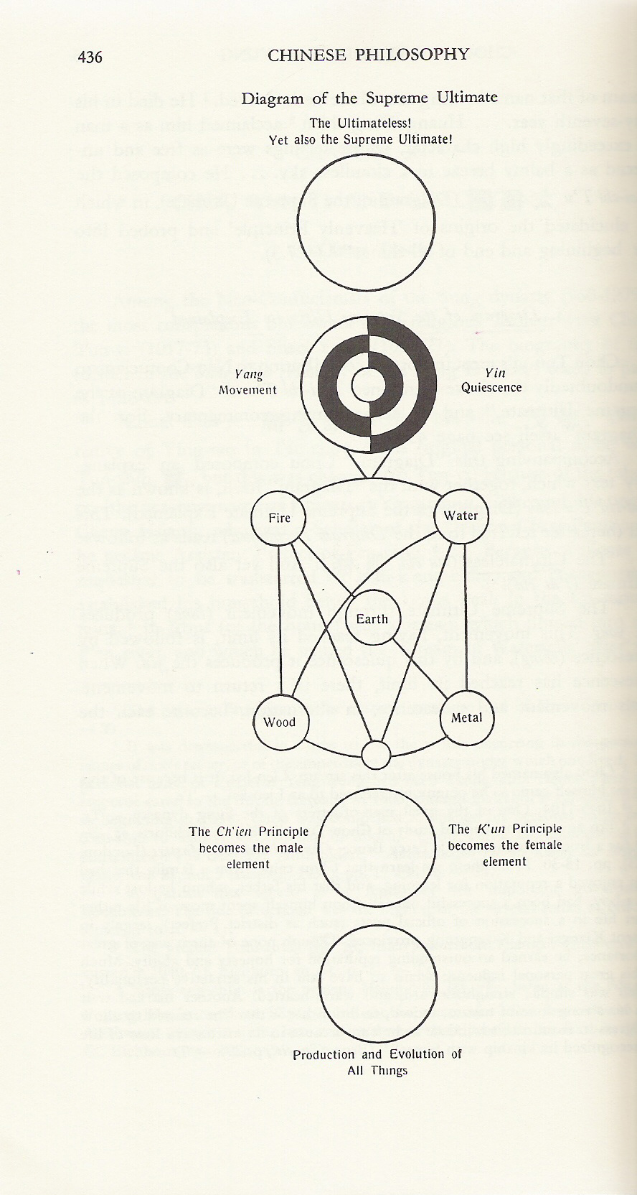

Slide 26
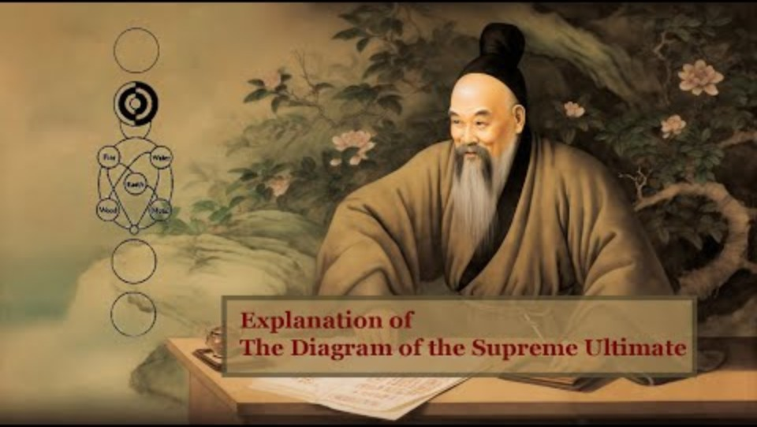

Slide 27
Neo-Confucians and their Thought
Cheng Hao & Cheng Yi
  Students of Zhou Dunyi
  Principle
  Quoted from Doctrine of the Mean
  Four Books
    Analects
    Mencius
    Great Learning
    Doctrine of Mean

Slide 28
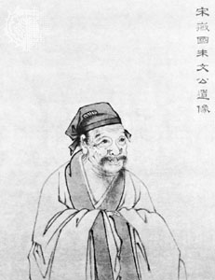
Neo-Confucians and their Thought
Zhu Xi (1130-1200)
  Synthesize
  Expurgate
  Monistic-dualism
Cultural Stability
Exported to Korea & Japan

Slide 29
Footbinding
A National Fetish

Slide 30

Footbinding
“Golden Lotus” – A three inch foot
Process begins from ages 5 – 7
Two year process
Risk of Sepsis and Death
Upward Marriage and the sexualization of the foot

Slide 31
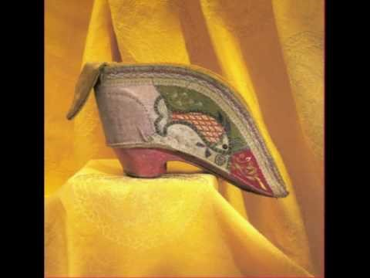
In Her Own Words
Notes:
http://youtu.be/U3hqKDHzYWc

Slide 32
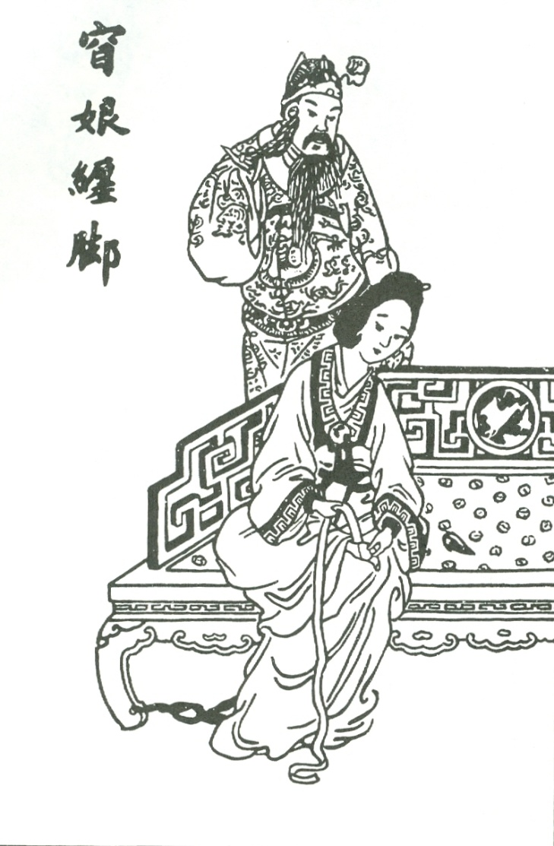
Origins
Origins lost to history
Only legends remain
  Fox Fairy (Xia)
  Yang Guifei (Tang)
  Yao Niang (Five Dynasties)
Literature and paintings indicate practice is widespread by the Northern Song
Yao Niang Binds her Feet

Slide 33
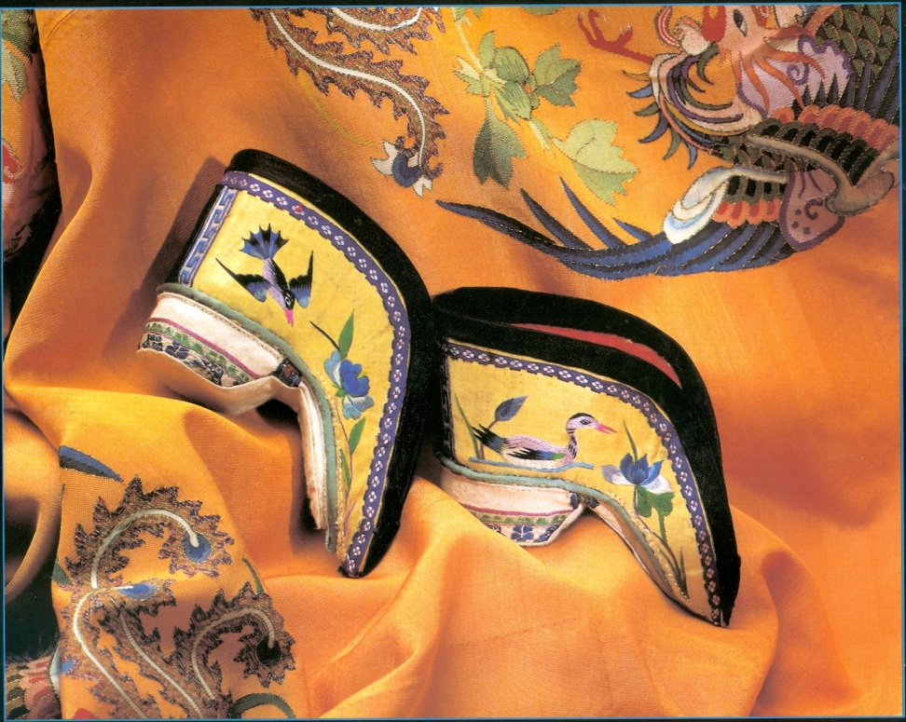
History
By Ming dynasty, spreads
throughout China
  Measurement of beauty
  and status symbol
  Marker of hierarchy
  Chance for upward marriage
By the end of the dynasty, custom spread to lower class women
Essentially a Han practice
  Hakka and other minorities did not bind feet

Slide 34
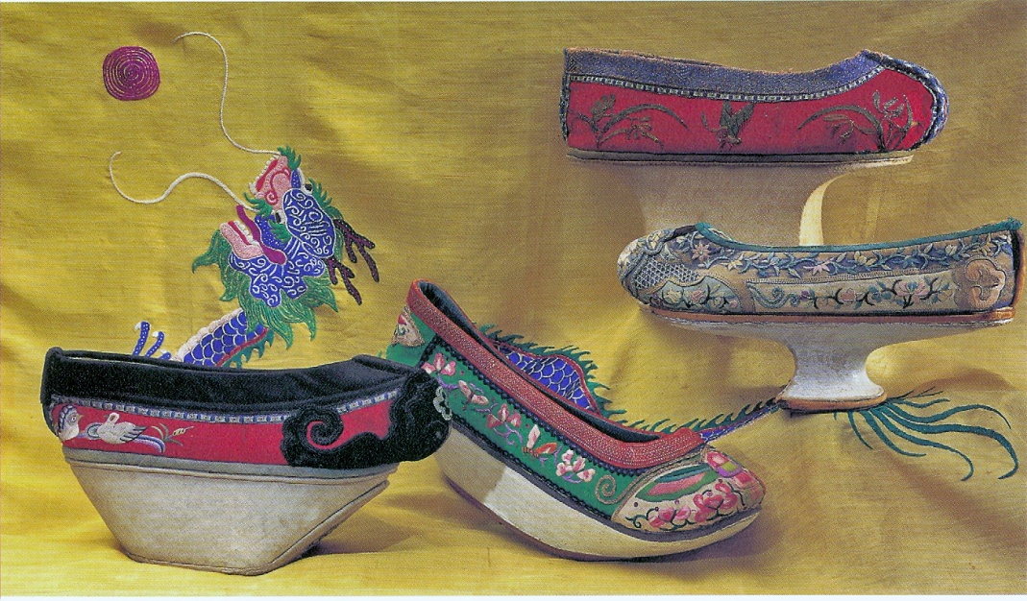
Footbinding and the Qing Dynasty
Qing (Manchu) Dynasty bans footbinding
  Like the queue, attempt to force assimilation into Manchu culture
  Ban fails among Han Women
Manchu women attempt to mimic “Lotus gait” with special shoes

Slide 35
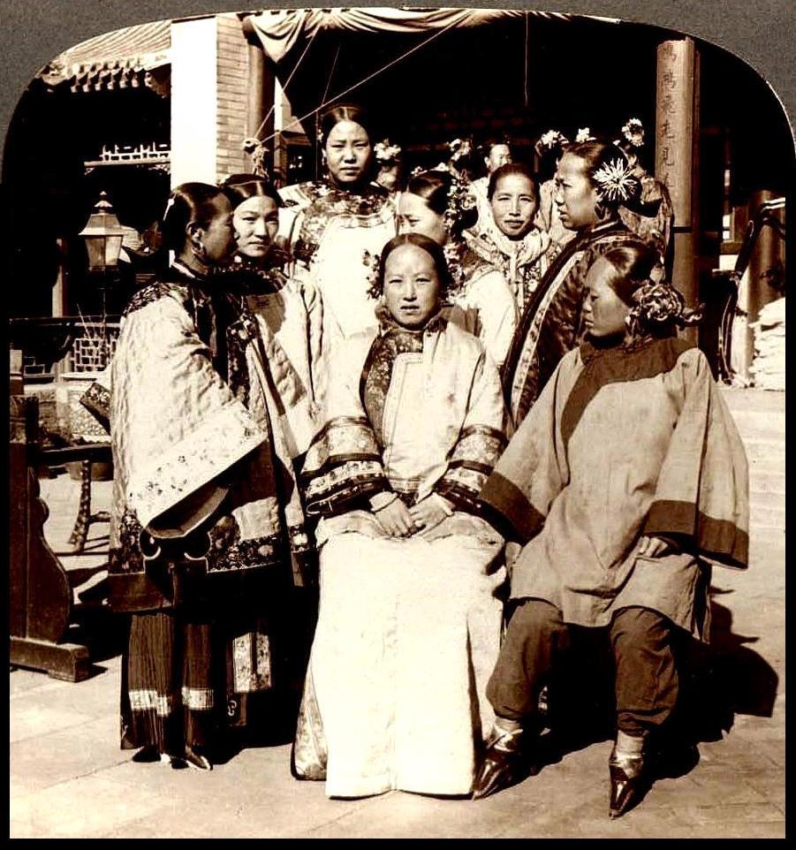
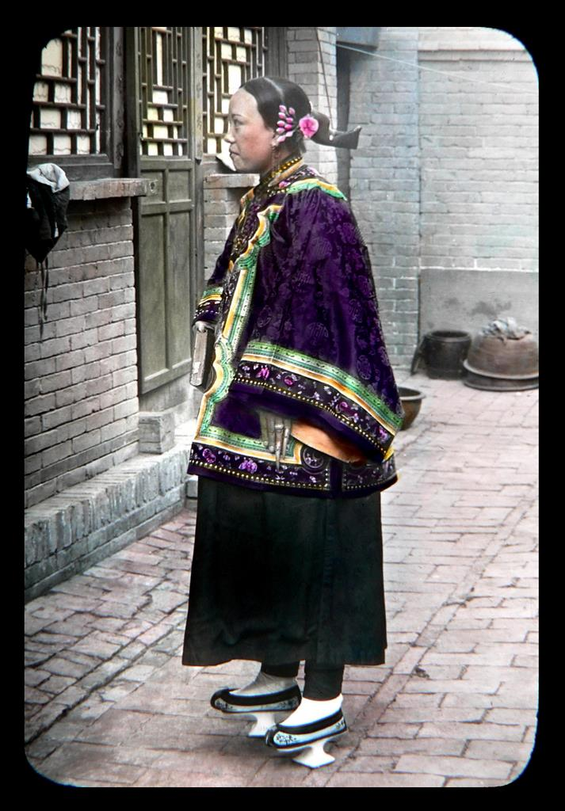
Manchu Women

Slide 36
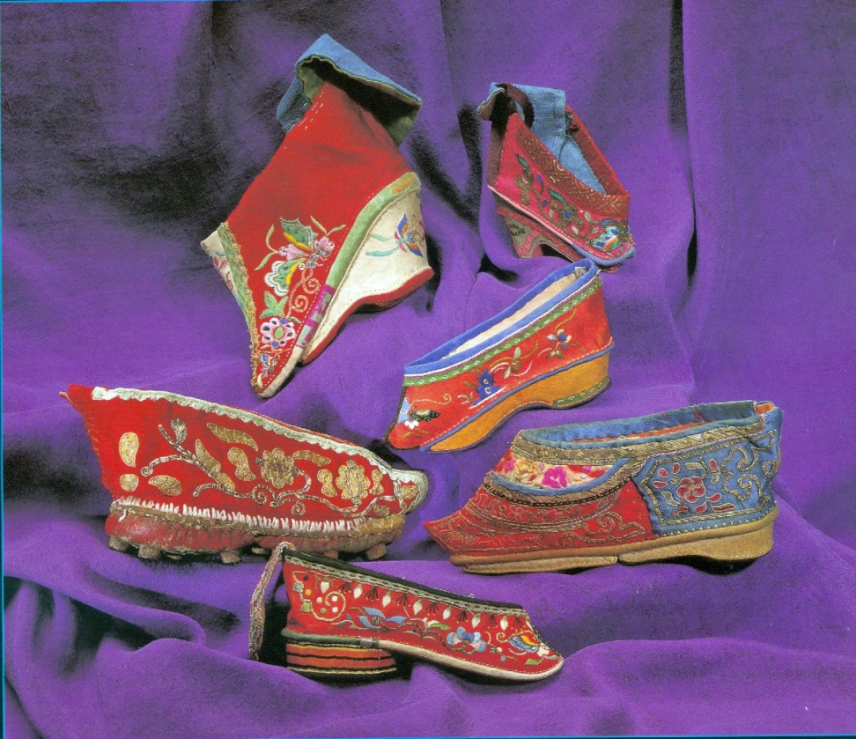
A National Fetish
Linkage to marriage and
male sexuality accounts for
longevity
Bindings create taboo
Taboo sexualizes foot
  Parallel to female breast in
  West
Becomes widespread fetish
  Even shoe becomes object of masturbatory fantasy
  Unbound foot becomes sex object during intercourse
“A plain face is given by heaven, but poorly bound feet is a sign of laziness.”

Slide 37
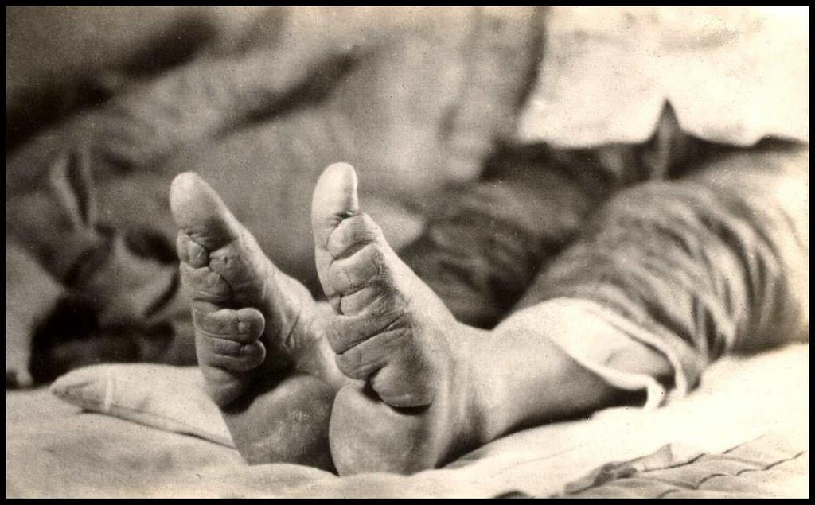
Anti-Footbinding Movement
19th century reformist
scholars criticize foot-
binding
  Patriarchal oppression and
  Subjugation of women
  Host demonstration exposing
  unbound feet; draws 1000s
Joined by Christian Missionaries
Republican China bans footbinding, imposing stiff fines
  Women continue to bind feet in secret

Slide 38
Judgements
Cultural Relativism?
History of Body Modifications
  Lip plates, head bindings, male circumcision, and female genital mutilations, piercings and tattoos

Slide 39
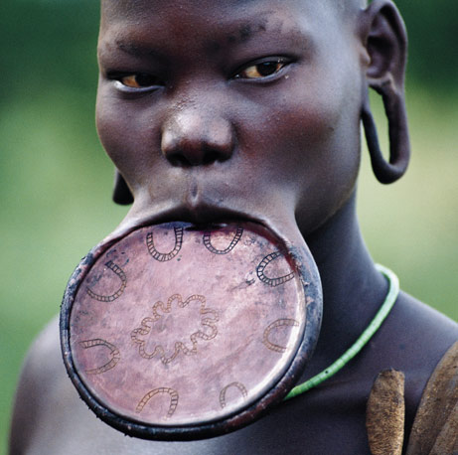

Slide 40
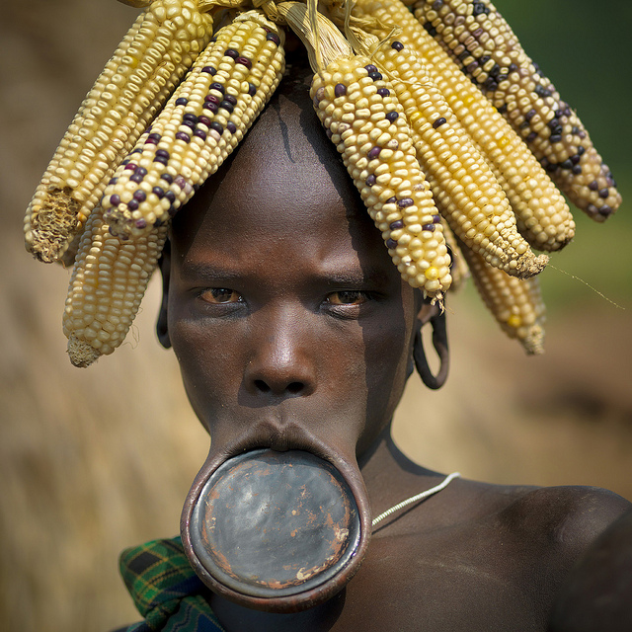

Slide 41
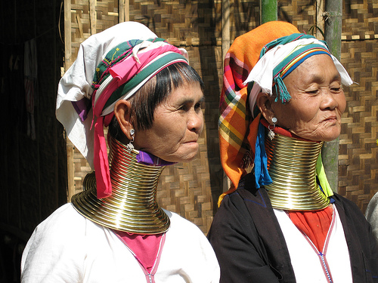

Slide 42
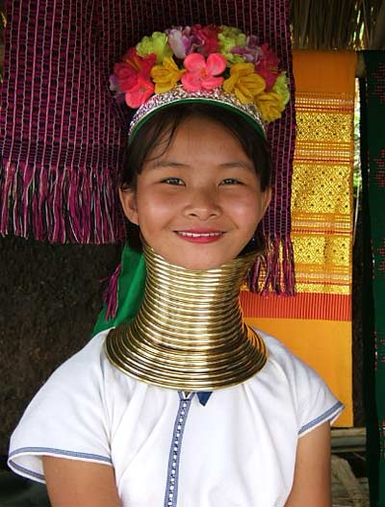

Slide 43
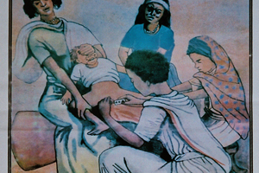
Notes:
An estimated 100 to 140 million girls and women in the world are victims of Female Genital Mutilation (FGM). In addition to life-long traumas, they often suffer from potentially fatal infections, bleeding and complications during childbirth. The harmful practice is among the main reasons for the high maternal mortality rates in Africa and Asia.
FGM is mostly performed by laypersons using primitive tools such as knives, glass cullets or razor blades to remove the clitoris, often with partial or complete excision of the labia majora. The most severe form of genital mutilation includes cutting the labia minora. The intervention is carried out without anesthesia.
This inhumane tradition is practiced in 28 countries of Africa and parts of Asia and the Middle East. The girls on whom the operation is performed are often under 14 years old. Through the cutting, they are supposed to enter into adulthood in a "clean" condition. Women on whom FGM has not been performed are often not considered as adequate wives by the respective ethnic groups.
Since the UN General Assembly of December 1993, Female Genital Mutilation is considered to be a specific form of violence against girls and women and thus an act of human rights violation, as confirmed by the International Conference on Population and Development in 1994 in Cairo at which its abolition was demanded.

Slide 44
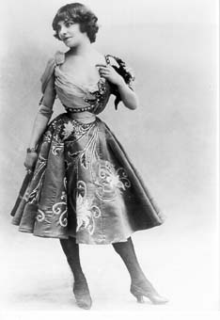

Judgements
Cultural Relativism?
History of Body Modifications
  Lip plates, head bindings, genital mutilations
Western aesthetic body modifications
  Corsets
  Breast augmentations
  High heels most parallel to footbindings
Notes:
http://exhibits.hsl.virginia.edu/clothes/
http://www.washingtonpost.com/national/health-science/high-heeled-shoes-may-look-good-but-theyre-bad-for-your-feet/2013/06/17/54945c14-c22d-11e2-914f-a7aba60512a7_story.html

Slide 45
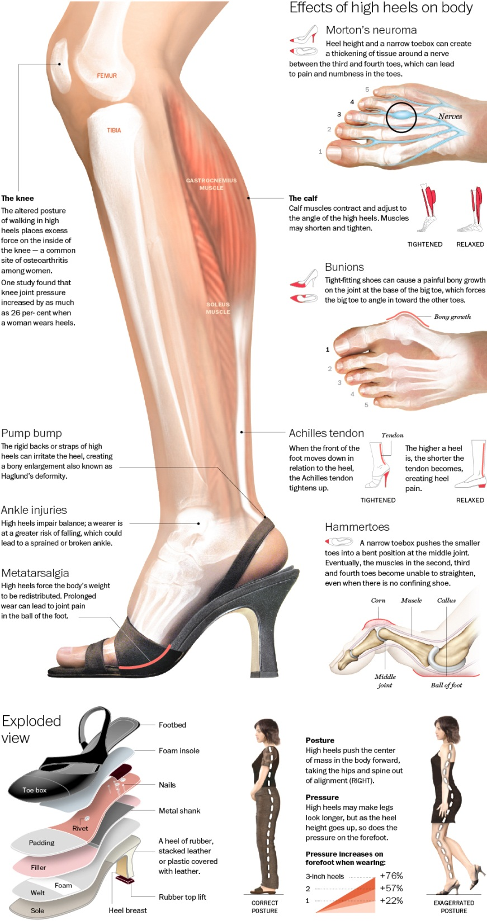
Effects of high heels on the body
Morton’s neuroma
Excessive force on inside of knee
Calf muscles shorten and tighten
Bunions = boney growth
Pump bump
Ankle injuries
Metatarsalgia – pain in ball of foot
Hammertoe – 3rd and 4th toe unable to straighten
Accentuates posterior for male gaze
Notes:
http://visual.ly/true-effect-high-heels?utm_source=visually_embed

Slide 46
Judgements
Cultural Relativism?
History of Body Modifications
  Lip plates, head bindings, genital mutilations
Western aesthetic body modifications
  Corsets
  Breast augmentations
  High heels most parallel to footbindings
Only different by degree
Notes:
http://exhibits.hsl.virginia.edu/clothes/
http://www.washingtonpost.com/national/health-science/high-heeled-shoes-may-look-good-but-theyre-bad-for-your-feet/2013/06/17/54945c14-c22d-11e2-914f-a7aba60512a7_story.html

